Slide 1
Alzheimer’s disease and related dementias in
New Mexico
Tommy Hernandez
Public Policy Director
Alzheimer’s Association of New Mexico
Jessica D. Richardson, PhD, CCC-SLP
Professor
University of New Mexico

Slide 2
Objectives
Overview of dementia (including Alzheimer’s disease)
Impact of dementia in New Mexico
Assessment and diagnosis of dementia
Treatment of dementia
Advancements and new research in dementia
Resources for dementia
Notes:
TOC

Slide 3
Disclosures - Hernandez
Salary from Alzheimer’s Association

Slide 4
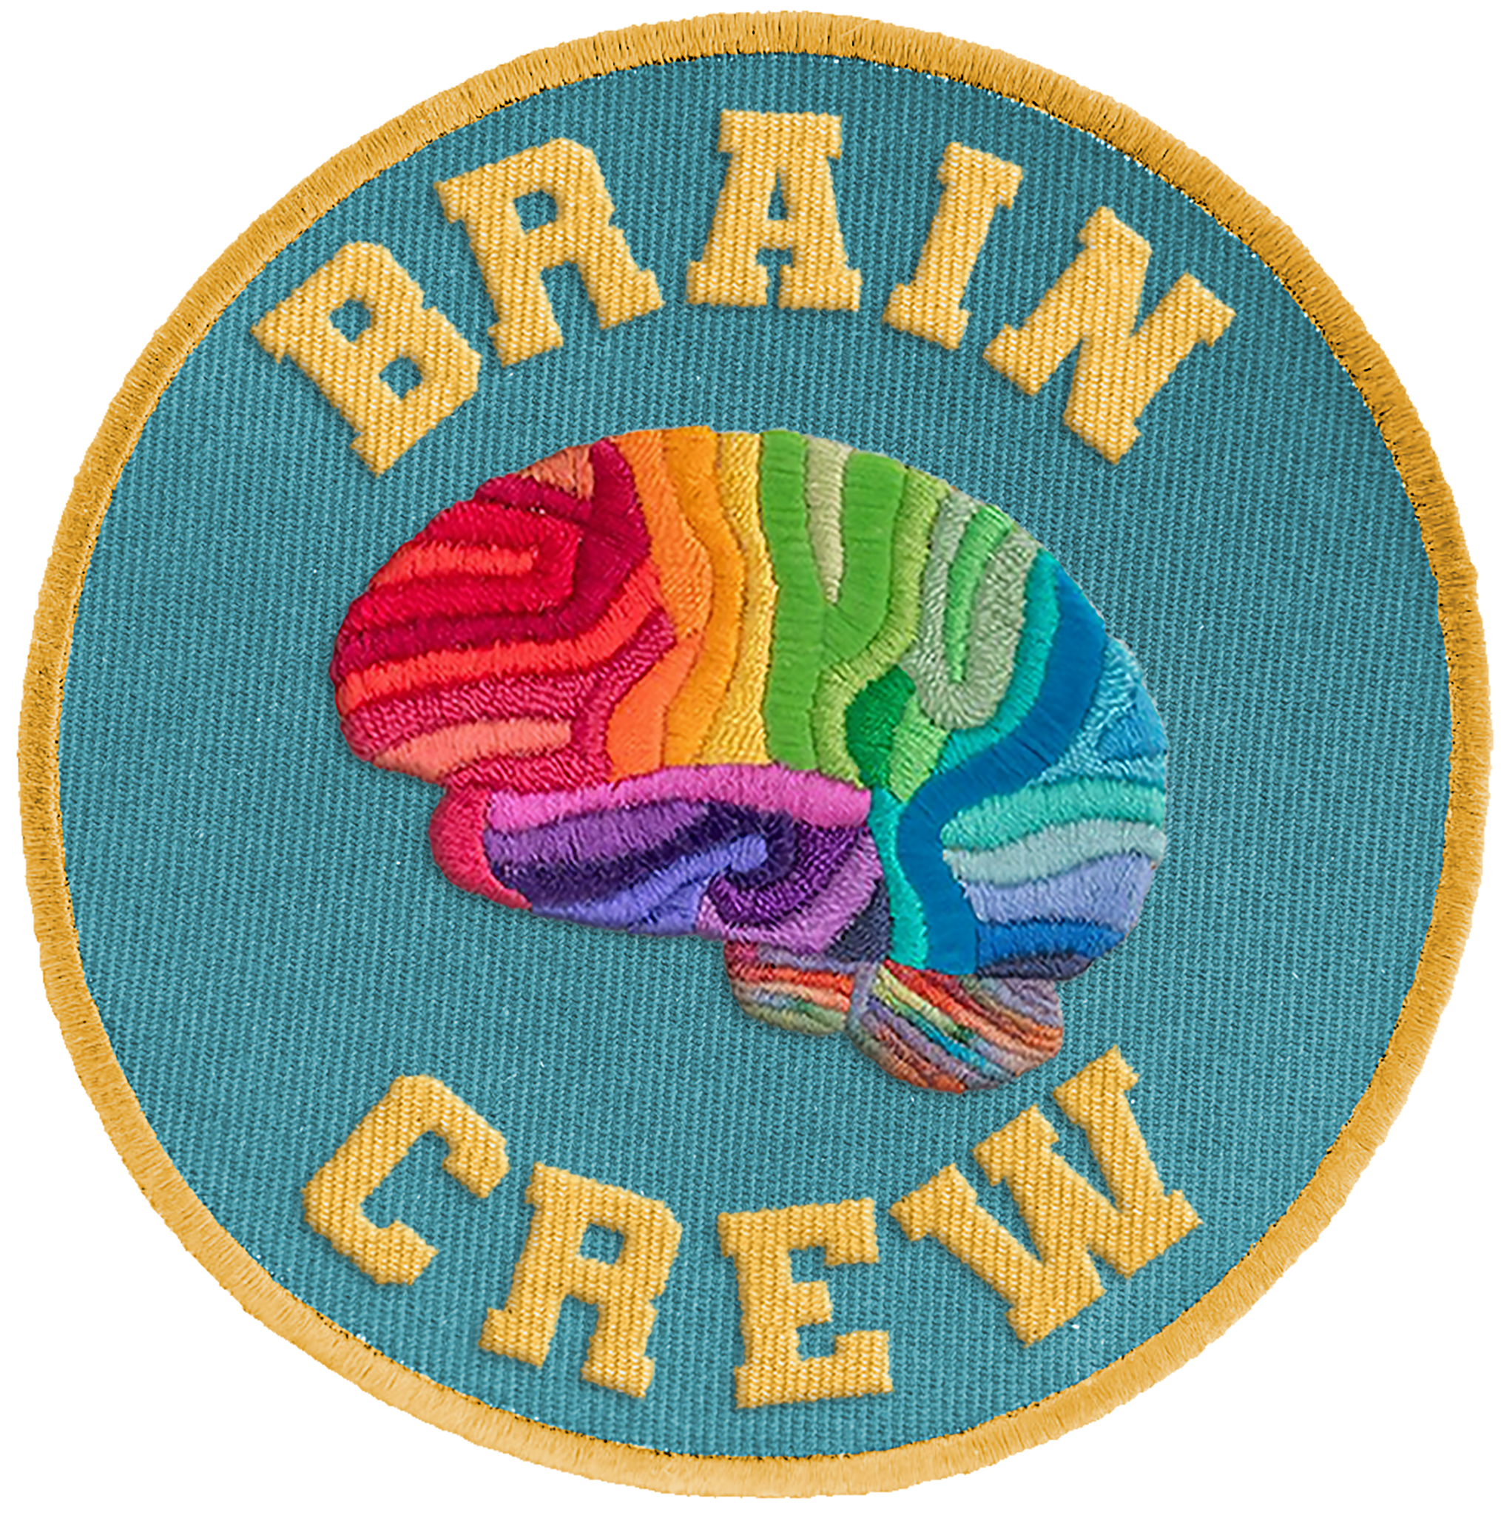
Disclosures - Richardson
Salary from the University of New Mexico
Current funding from the National Institutes of Health, Department of Defense, and SingWell Canada
Previous funding from the New Mexico Governor’s Commision on Disability
Leadership positions for the UNM Center for Brain Recovery and Repair and the NM Alzheimer’s Disease Research Center

Slide 5
Objectives
Overview of dementia (including Alzheimer’s disease)
Impact of dementia in New Mexico
Assessment and diagnosis of dementia
Treatment of dementia
New research in dementia
Resources for dementia
Notes:
TOC
JDR

Slide 6
What is dementia?
According to the National Institutes of Health (NIH), “dementia is the loss of cognitive functioning - thinking, remembering, and reasoning - to such an extent that it interferes with a person’s daily life and activities”
There are different types of dementia - you can think of the word “dementia” as an umbrella term.
Dementia

Slide 7
Dementia
*image from Constant Therapy

Slide 8
Dementia
AD - Alzheimer’s disease
VaD - Vascular dementia
LBD - Lewy body dementia
FTD - Frontotemporal dementia
Not shown:
PDD - Parkinson’s disease dementia
HS - Hippocampal sclerosis
Mixed - Mixed causes/pathology
………and more
*additional information from Alzheimer’s Association

Slide 9
These dementias are caused by damage to brain cells which interferes with the ability of those cells to communicate with each other.
Symptoms start out slowly and gradually get worse*.

Slide 10
VaD
A person with VaD may be able to maintain abilities if the underlying vascular condition is treated, or they may worsen over time.

Slide 11
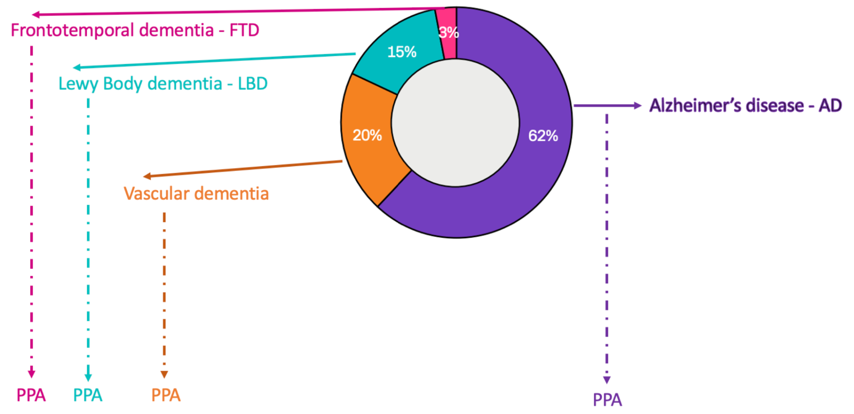
Primary Progressive Aphasia
Notes:
When this happens it is a dementia syndrome that we call Primary progressive aphasia (PPA)
It is still due to AD or LBD or other dementia, but it is helpful to know when it is PPA, as this can help guide treatment and management

Slide 12
Primary Progressive Aphasia

Slide 13
Objectives
Overview of dementia (including Alzheimer’s disease)
Impact of dementia in New Mexico
Assessment and diagnosis of dementia
Treatment of dementia
New research in dementia
Resources for dementia
Notes:
DS

Slide 14
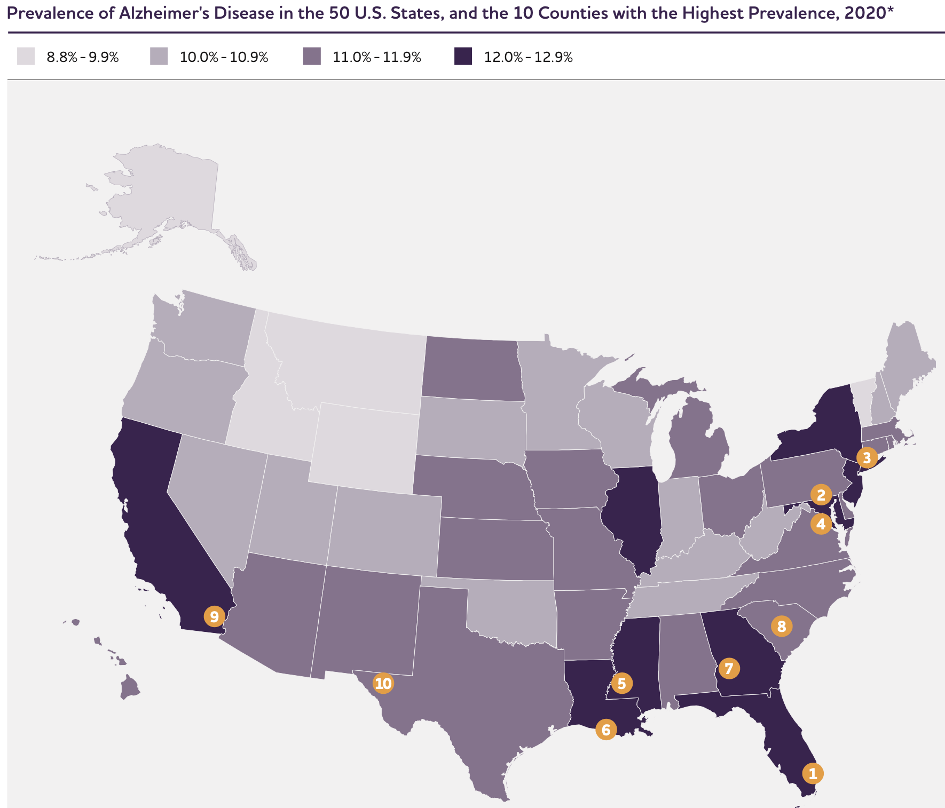
*image from Alzheimer’s Association

Slide 15
People living with dementia:
Note re: minoritized ethnoracial groups:
Dementia more frequent in these groups, and…
Dementia is underdiagnosed in these groups (so probably even more frequent than we think!)
There are more barriers to research, treatment, and support for these groups
Note re: women:
Alzheimer’s disease is more common in women (and this is the most common type of dementia)
These numbers only reflect Alzheimer’s disease data. They are higher when counting all dementia.

Slide 16
Caregivers:
Note re: women:
Caregivers - paid and unpaid/informal - are more likely to be women
These numbers only reflect Alzheimer’s disease data. They are higher when counting all dementia.

Slide 17
Healthcare workforce:
What are we doing to prepare for this?
Alzheimer’s Association working on a bill to increase # of paid caregivers
NM ADRC working on a bill to increase # of community health workers/social workers

Slide 18
Objectives
Overview of dementia (including Alzheimer’s disease)
Impact of dementia in New Mexico
Assessment and diagnosis of dementia
Treatment of dementia
New research in dementia
Resources for dementia
Notes:
TOC
JDR

Slide 19
Diagnosing Dementia - Early Signs (1)
Early signs of dementia are exaggerated forms of minor day-to-day lapses
Memory example:
Occasionally forgetting an appointment, missing a deadline, remembering neighbor’s name
VS
Forgetting that you even made an appointment or that you were working on something with a deadline, not recognizing a neighbor

Slide 20
Diagnosing Dementia - Early Signs (2)
Early signs of dementia are exaggerated forms of minor day-to-day lapses
Orientation example:
Occasionally forgetting what day of the week it is or getting lost in unfamiliar places
VS
Routinely not knowing what day it is or what time of day it is; getting lost in familiar places

Slide 21
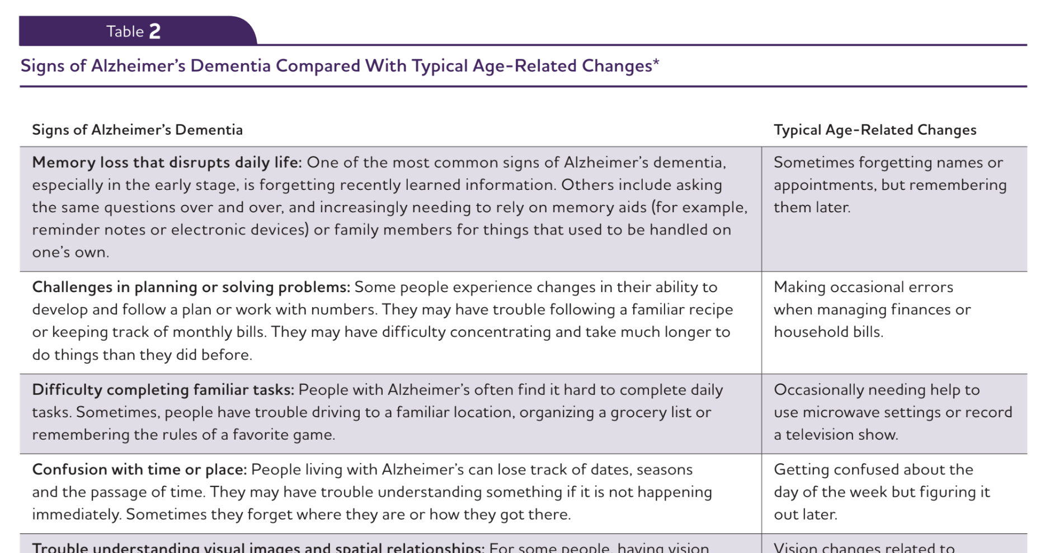
*snapshot of helpful resource from Alzheimer’s Association

Slide 22
Diagnosing Dementia - Assessment (1)
Clinical interview (with person and their family members and/or friends)
Concrete examples are most helpful, especially of how perceived cognitive or behavioral problems are impacting everyday life
Information regarding timeline also helpful
Review of medical records

Slide 23
Diagnosing Dementia - Assessment (2)
Neuropsychological assessment
Standardized cognitive tests with age and education norms for comparison
Includes assessment of affect/mood to rule out a primary role of a psychological issue

Slide 24
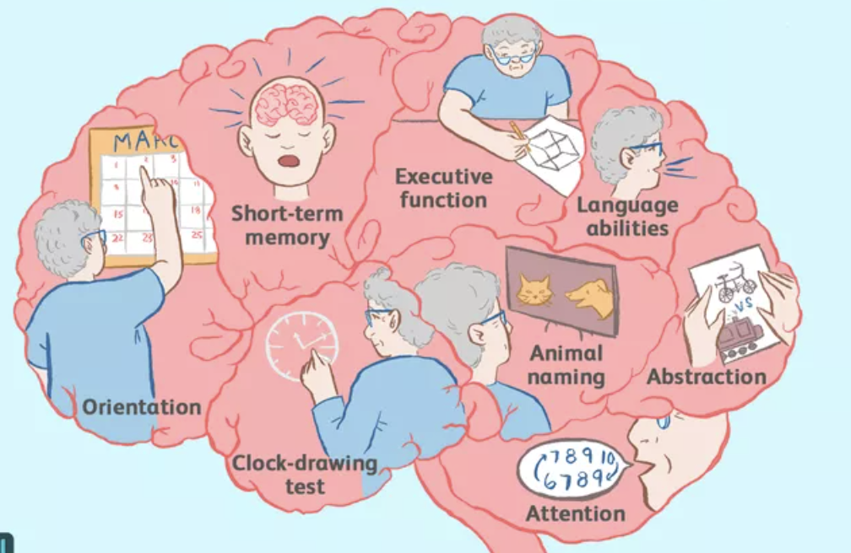
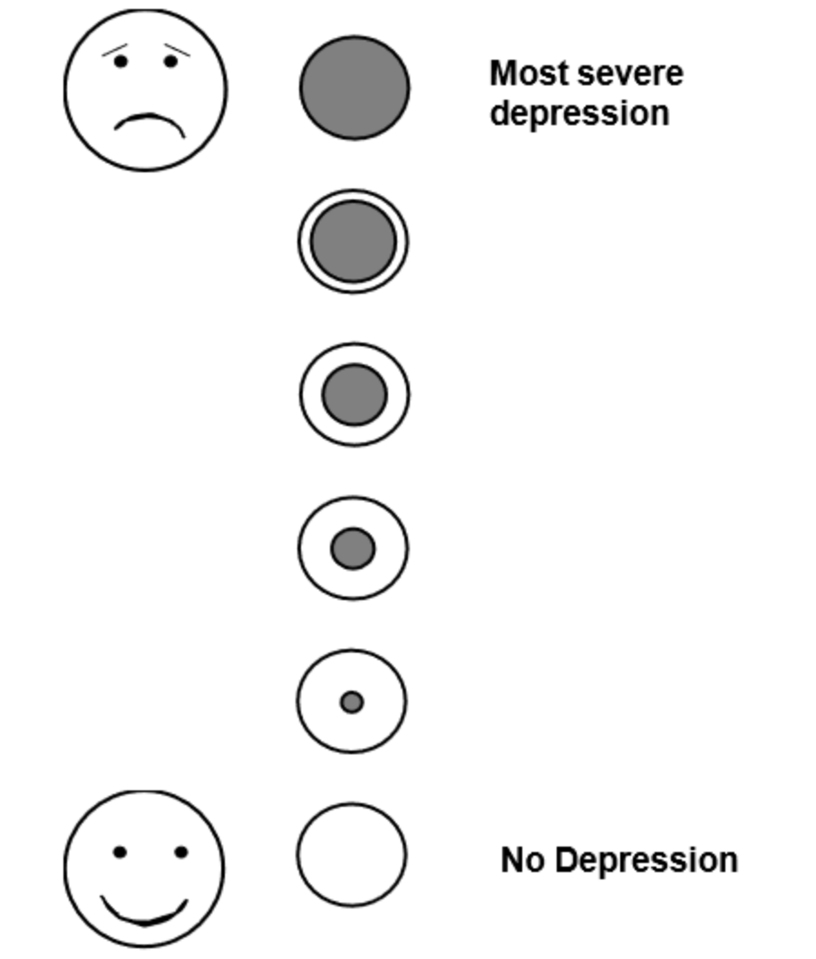
Diagnosing Dementia - Assessment (3)

Slide 25
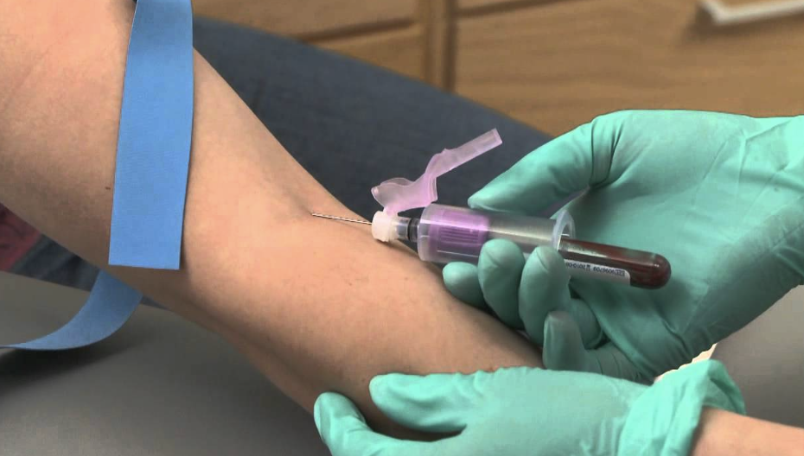
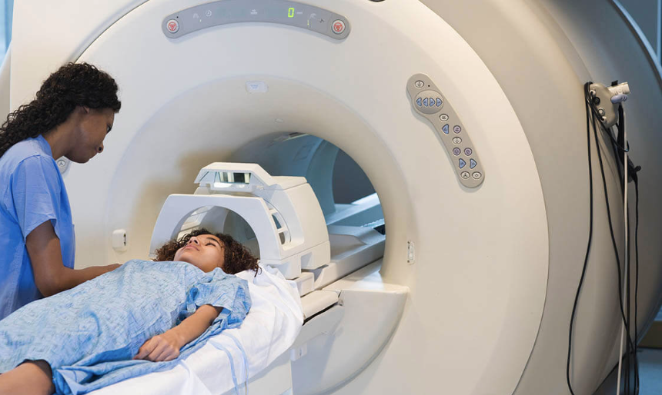
Diagnosing Dementia - Assessment (4)

Slide 26
Diagnosing Dementia - Interpretation
Test results are compared to norms (adjusted for age/educ)
Based upon deficits in cognition and other history and exam results, a diagnosis of dementia is considered
NORMAL: as expected for age/educ
DEPRESSED/ANXIOUS
SUBJECTIVE COGNITIVE IMPAIRMENT: reporting symptoms but exam seems normal
MILD COGNITIVE IMPAIRMENT: cognition is not as good as expected but not severe
DEMENTIA: more noticeable symptoms to severe symptoms
More work will then be done to determine which TYPE of dementia

Slide 27
Objectives
Overview of dementia (including Alzheimer’s disease)
Impact of dementia in New Mexico
Assessment and diagnosis of dementia
Treatment of dementia
New research in dementia
Resources for dementia
Notes:
JDR

Slide 28
TREATMENT
CURATIVE
SYMPTOMATIC
PHARMACOLOGICAL
NON-PHARMACOLOGICAL
CURATIVE: treating the cause of the illness
Example: treating an infection
SYMPTOMATIC: treating the symptoms of the illness
Example: treating fever from infection

Slide 29
SYMPTOMATIC
PHARMACOLOGICAL
ACh (Acetylcholinesterase) inhibitors
Donepezil, Galantamine, Rivastigmine
NMDA receptor antagonists
Memantine
Other
Medications for tremor, mood, etc.
Taper and stop alcohol, cigarettes, caffeine
Taper and stop meds that make symptoms worse
Anticholinergics
Benzodiazepines
First generation antihistamines “PM” or “ZZ”
Some prescription insomnia meds also called “Z”
Ambien, Lunesta, Sonata, etc.

Slide 30
SYMPTOMATIC
Treatment will help with maintaining skills, compensating for lost skills, and preparing for what is ahead.
Several key providers:
Counselor
Occupational therapist (OT)
Physical therapist (PT)
Social Worker
Speech-language pathologist (SLP)
Lifestyle changes
Diet, exercise, sleep, stress
Environmental modifications
Support groups
NON-PHARMACOLOGICAL

Slide 31
TREATMENT
CURATIVE
SYMPTOMATIC
PHARMACOLOGICAL
NON-PHARMACOLOGICAL
Some hope for the future:
It is estimated that treatment research for Alzheimer’s disease is where cancer treatment was ~ 50 years ago.
But we are moving at a faster rate because of advanced technology and innovations, so it won’t take us 50 years to catch up to where cancer is now.

Slide 32
Objectives
Overview of dementia (including Alzheimer’s disease)
Impact of dementia in New Mexico
Assessment and diagnosis of dementia
Treatment of dementia
Advancements and new research in dementia
Resources for dementia
Notes:
TOC
JDR THEN DS

Slide 33
PHARMACOLOGICAL | NONPHARMACOLOGICAL
Anti-amyloid therapy Only for Alzheimer’s disease or mixed-Alzheimer’s disease Aducanumab, Lecanemab, Donanemab Not available in NM yet No public funding yet, so not approved yet Prohibitively expensive Requires infrastructure NM does not yet have | Behavioral therapies (cognitive, speech-language, etc.) Prophylaxis (to protect/preserve more intact skills) Improvement of declining skills Brain stimulation therapies Music therapy Exercise

Slide 34
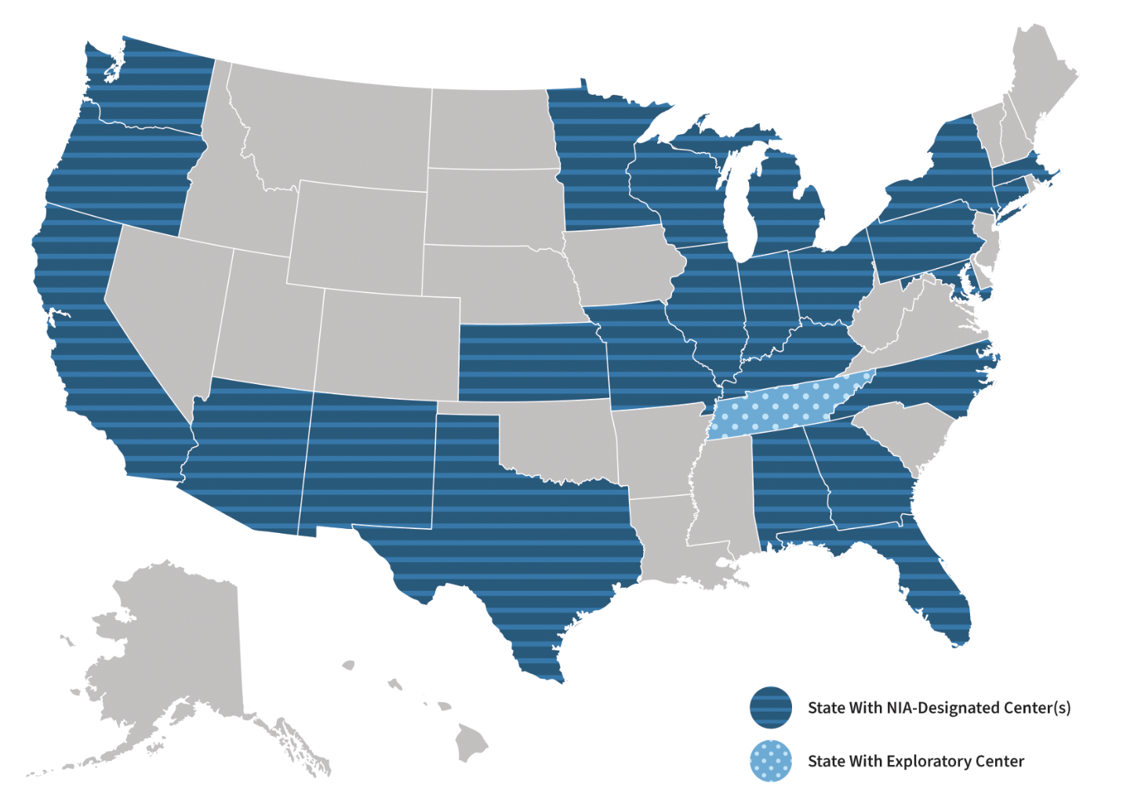
UNM Center for Memory and Aging awarded funding to become an exploratory Alzheimer’s Disease Research Center (eADRC) in 2020 and a FULL-FLEDGED ADRC in 2024!

Slide 36
Clinical Core
Outreach, Recruitment, and Engagement Core
Primary stakeholders/partners:
NIH National Institute on Aging
Project ECHO
Center for Native American Health
State of New Mexico ALTSD
National Labs
Tribal Advisory Boards
Community Advisory Boards
and community members
Alzheimer’s Association of New Mexico

Slide 38
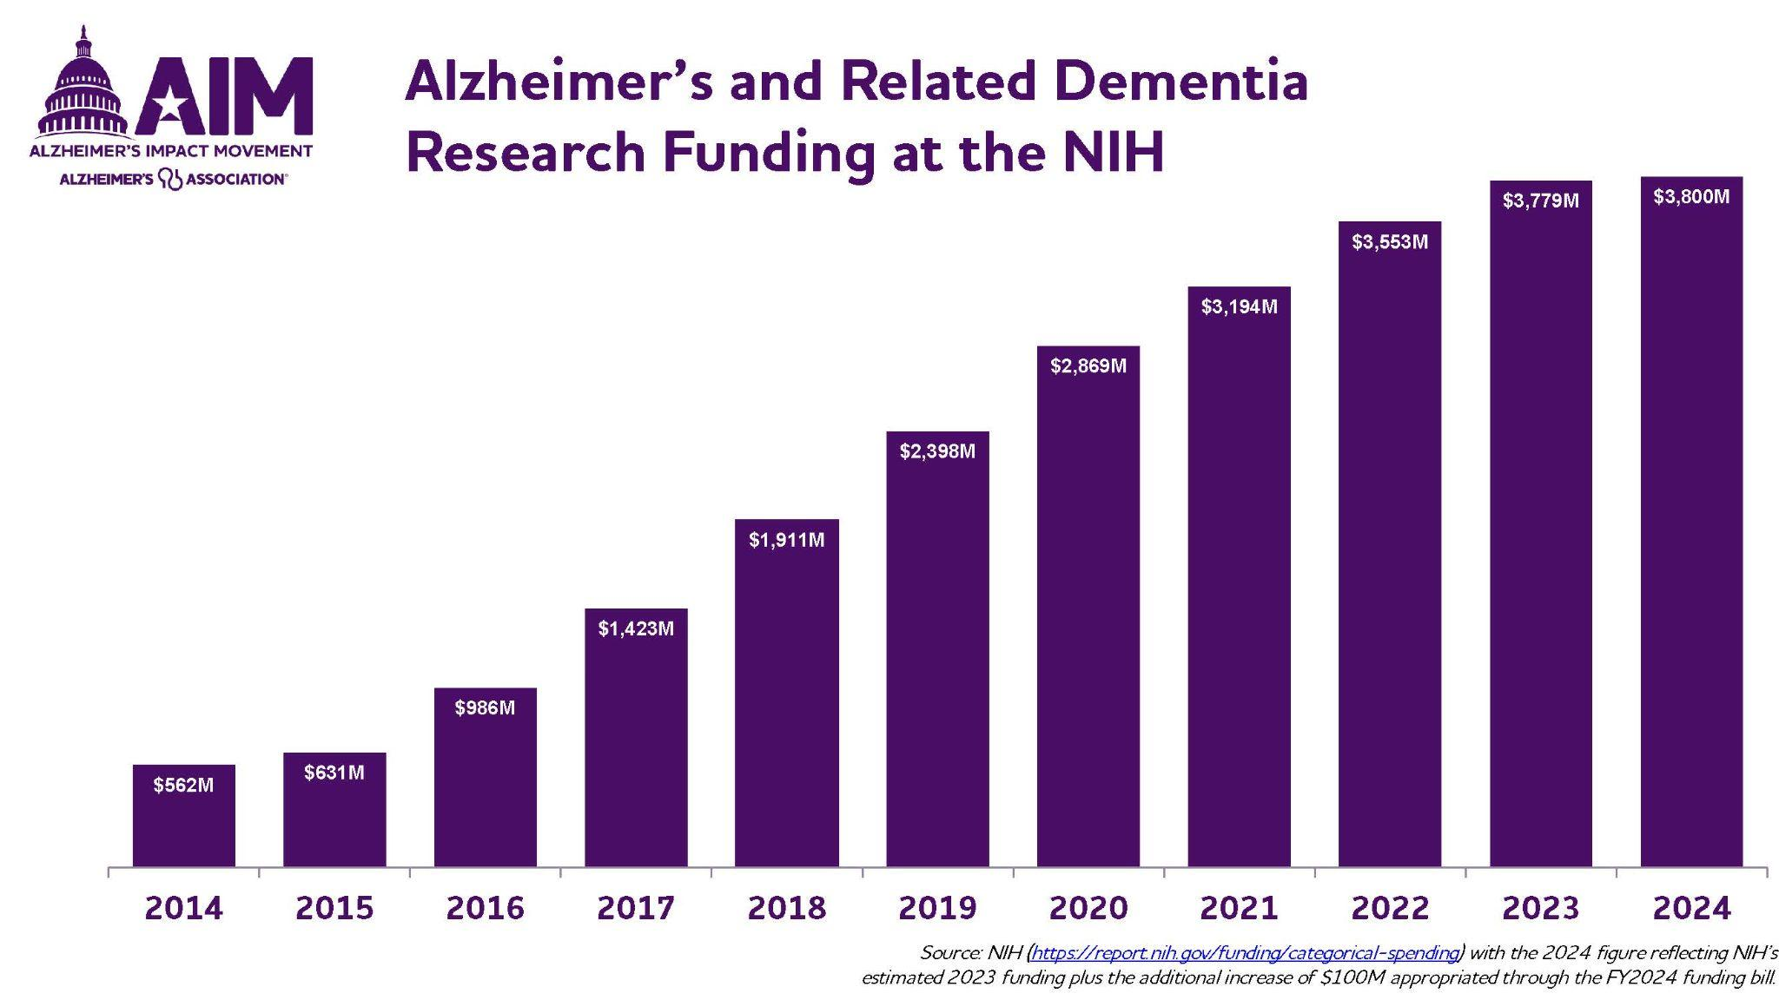
*image from Alzheimer’s Association
Notes:
QR CODES?

Slide 39
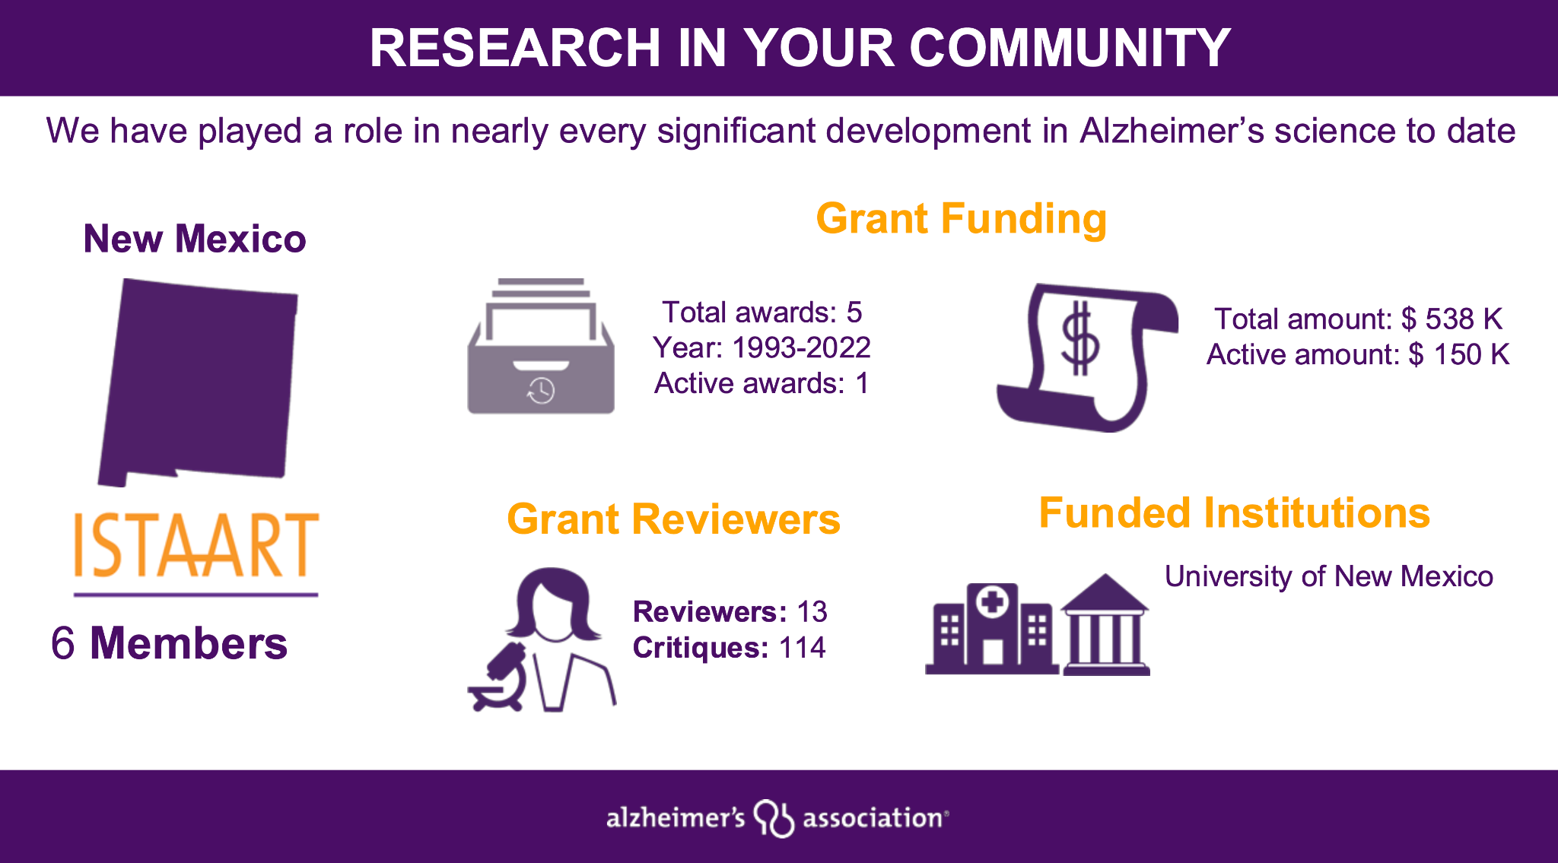
*image from Alzheimer’s Association
Notes:
QR CODES?

Slide 40
Objectives
Overview of dementia (including Alzheimer’s disease)
Impact of dementia in New Mexico
Assessment and diagnosis of dementia
Treatment of dementia
New research in dementia
Resources for dementia
Notes:
DS (INCLUDING JDRS STUFF)

Slide 41
Aka
“Outreach and Education”
Vestibulum congue
CONCERN AND AWARENESS
Vestibulum congue
Vestibulum congue
CARE AND SUPPORT
ADVOCACY AND FUNDING
Notes:
QR CODES?

Slide 42
Notes:
QR CODES?

Slide 43
How are we working together to provide/develop resources?
Coordinating regarding support programs and groups for people living with dementia
Coordinating regarding training, support (including groups) for family caregivers
Coordinating regarding training of healthcare providers and lay community
Working together on legislative efforts
Sharing outreach and education resources
Coordinating regarding development of new outreach and education resources

Slide 44
Digital resource repositories
https://www.alz.org/help-support/resources
https://drive.google.com/drive/folders/18rTHhl5e7ReZ1GS0SJB_-IUgnBi4lLzt
https://youtube.com/playlist?list=PLy586K9YzXUxp9WGtfdjIZTk6mSK6ctbS&si=IrRp14mnjWyLMxC4

Slide 45
Alzheimer’s Association of New Mexico | https://www.alz.org/newmexico |  | 505-266-4473 1-800-272-3900
New Mexico Aging and Long-Term Services | https://aging.nm.gov/ | nm.adrc@altsd.nm.gov | 505-476-4799
New Mexico Alzheimer’s Disease Research Center | https://hsc.unm.edu/research/centers-programs/nmadrc/ | NMADRC@salud.unm.edu NMADRC@gmail.com | 505-277-3315
UNMH Senior Health Center | https://unmhealth.org/services/senior-health.html | unm-mac@salud.unm.edu | 505-272-4866

Slide 46
THANK YOU

