Slide 1
BEYOND THE APS INVESTIGATION:
PREVENTION, INTERVENTION & HARM REDUCTION
Roberta Farley, MA, CCHW
Clinical Operations Manager – Adult Protective Services

Slide 2
TRIGGER WARNING
The following presentation contains materials and content that may be disturbing to some participants. ​
Please feel free to leave the room or the session to care for yourself if you become distressed by the content in this presentation. ​
There is no guarantee of privacy in a public learning environment should you choose to share personal stories of abuse.

Slide 3
Objectives
Today we will cover:
An overview of Elder and Disability Abuse
The impacts of each type of abuse
NM’s three-pronged model:
1) Prevention, 2) Intervention, 3) Harm Reduction
Signs of abuse, resources to help, and how to report and respond

Slide 4
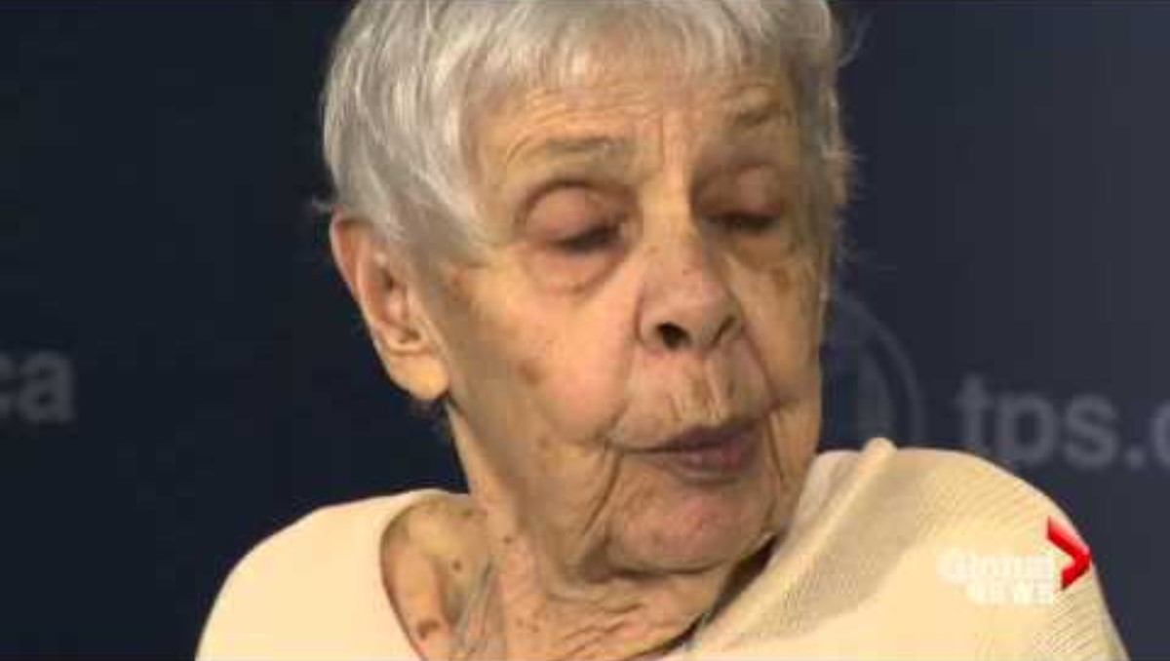
"ELDER ABUSE VICTIM SPEAKS"
Notes:
This video is from Canada, but illustrates that this abuse occurs no matter where you go in the world. We will watch and discuss after.

Slide 5
What is “elder” abuse?
Any knowing, intentional or negligent act by a caregiver or any other person that causes harm or a serious risk of harm to a vulnerable adult
Physical Abuse
Inflicting physical pain or injury
Restraining by physical or chemical means, isolation
Sexual Abuse
Non-consensual contact of any kind
Includes sexual acts with a person lacking ability to consent
Emotional Abuse
Inflicting mental pain, anguish or distress
Includes verbal or non-verbal acts
Notes:
Elder in quotations – the term elder or elderly has a negative connotation in many societies/for some individuals due to the implication that elders are not able to care for themselves.
The preferred terms are “older adult” and vulnerable adult to avoid ageism

Slide 6
What is “elder” abuse?
Any knowing, intentional or negligent act by a caregiver or any other person that causes harm or a serious risk of harm to a vulnerable adult.
Neglect
The failure by those responsible to provide food, shelter, health care, or protection for a vulnerable adult
Abandonment
Desertion of a vulnerable adult by anyone who has assumed responsibility for care or custody
Exploitation
The illegal taking, misuse or concealment of funds, property or assets of an older adult for someone else’s benefit
Self Neglect
Failure to perform essential self-care tasks; such failure threatens their own health or safety
Notes:
Elder in quotations – the term elder or elderly has a negative connotation in many societies/for some individuals due to the implication that elders are not able to care for themselves.
The preferred terms are “older adult” and vulnerable adult to avoid ageism

Slide 7
National Statistics
90%
14.9%
1/10
5 million
2/3
of older adults reside in the community
of the U.S. population is represented by people 65+
of Americans 60+ have experienced abuse
Older adults abused each year
of victims of abuse are women

Slide 8
National Statistics, Pg 2
In approximately 60% of ALL cases, the perpetrator is a family member
An estimated 13.5% of older adults experience emotional abuse
beginning at 60
87% of emotional abuse and 57% of physical abuse is committed by partners
Some studies estimate rates of abuse have increased by 84% in the US and continue to rise
Notes:
Take note of the relationships here. They are similar to some other victim populations, but very different from others.
Rates of abuse up to 84%, continue to rise – why might that be? Engage the audience on this.
60+ of ALL cases the perp is family this is a national statistic that applies to abuse in ALL cases, which would include cases in nursing homes, and other facilities. This number increases when we look at community settings only (the home where 90% of Elders live – then this jumps up to 90%). This number is confounded by people living in SNFs, where much more abuse is committed by staff.
2/3 staff reported last year that they have committed abuse in a facility

Slide 9
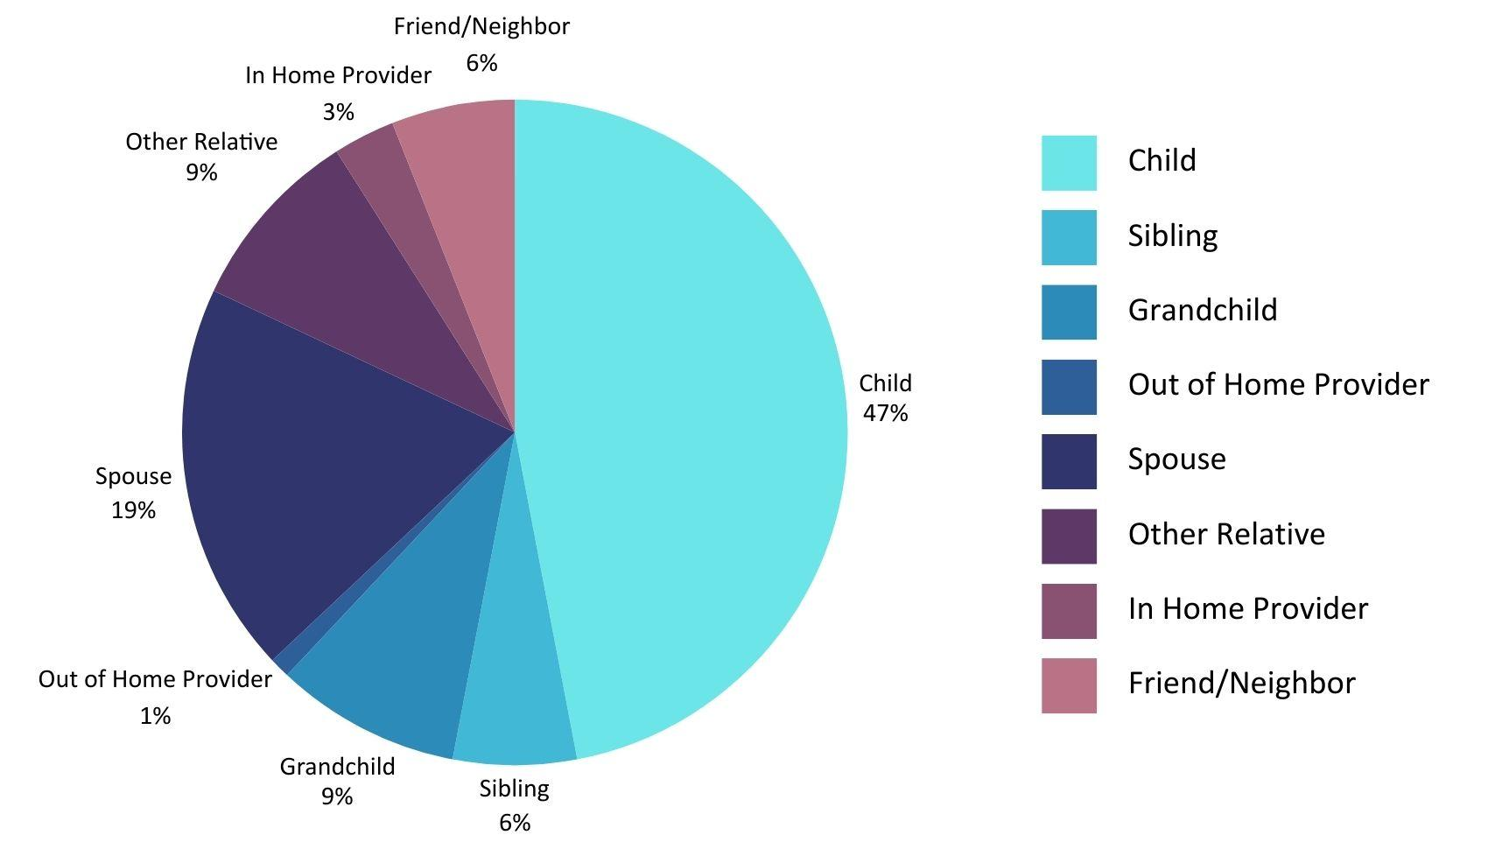
Relationship of victim to offender: community living

Slide 10
New Mexico APS data
APS Intake received 14952 reports (an increase of about 19%)
7629 clients received an investigation (an increase of about 11%)
961 clients were found to be victims (all abuse types including self-neglect)
Notes:
Little less than 19%
Little more than 11%

Slide 11
CONTRIBUTING FACTORS IN ABUSE OF OLDER ADULTS
Mental illness
Cognitive impairment
History drug or alcohol use/abuse
Current physical health problem(s)
History of violent/disruptive behavior
History of trauma/abuse
High stress levels
Inadequate coping
Isolation
Individual Factors
Societal/Social Factors
Financial/Emotional dependence​
Family conflict (past or current)
Lack of prosocial relationships
Lack of social support
Staffing problems (caregivers)
Lack of caregiver training/oversight
Caregiver stress/burnout
Relationship to abuser
Ageism
Notes:
Many of these are framed as individual risk factors of the victim, however most of these factors also apply to perpetrators.
Review each one regarding to explain how these apply to both victims and perps.

Slide 12
SIGNS OF ABUSE IN OLDER ADULTS
Unexplained bruises, cuts, burns, scars,
signs of restraint ​
Bed sores or other preventable conditions
Lacks necessary medical aids (glasses, walker, meds)
Person/home is messy, dirty or
smells bad
Stops taking part in activities they enjoy; isolation
Hazardous or unsafe living conditions; hoarding
Insufficient care, unpaid bills, eviction notices
Changes in emotional or social functioning; acting out
Behavioral changes in the presence of certain people
Unexplained weight loss/changes in eating patterns
Changes in functioning, ADLS, sleeping habits
Genital injury, pain, STDs, unusual sexual behavior

Slide 13
Visual examples of abuse
Hoarding
Organized hoarding
Pressure sore
Bed bugs
Restraint bruising
Animal hoarding
Notes:
Warn participants about the images
Hoarding – what risks can you see here and what might we think is happening with this victim?
Organized hoarding – what is the difference between this and the last picture? What do you think has happened?
Pressure sore – Decubitus ulcer, pressure ulcer all the same. Most common locations are butt, tailbone, heels, ankles, hips, back, elbows, shoulders, back of head. There are
Stage 1 sores are not open wounds. The skin may be painful, but it has no breaks or tears. The skin appears reddened. In a dark-skinned person, the area may appear to be a different color than the surrounding skin, but it may not look red.
At stage 2, the skin breaks open, wears away, or forms an ulcer, which is usually tender and painful. The sore expands into deeper layers of the skin. It can look like a scrape (abrasion), blister, or a shallow crater in the skin. Sometimes this stage looks like a blister filled with clear fluid. At this stage, some skin may be damaged beyond repair or may die.
During stage 3, the sore gets worse and extends into the tissue beneath the skin, forming a small crater. Fat may show in the sore, but not muscle, tendon, or bone.
At stage 4, the pressure injury is very deep, reaching into muscle and bone and causing extensive damage. Damage to deeper tissues, tendons, and joints may occur. Some sores cannot be staged.
Bed Bugs – think about impact on aging or delicate skin prone to breakdown.
Restraint bruising – The picture of the ankle is a deceased person, if you are wondering. This person was living in a nursing home and had multiple bruises of various healing stages consistent with restraint marks.
Animal hoarding – evidence of? What do you think all the brown stuff is??

Slide 14
Abuse of people living with disabilities
An intentional act or failure to act that causes or creates risk of harm to a person with a disability
Elements of Disability Abuse
Physical, sexual, emotional abuse, exploitation or neglect
Likely to be abused repeatedly and by a caregiver
More likely to remain in abusive situations
Are less likely to access the criminal justice system
Disability specific abuse: using someone’s disability to manipulate/exploit them
Notes:
Same basic definition we have seen for “Elder Abuse”
Same general categories.
People with disabilities often face capacity issues and are not able to consent to many actions (sexual acts, financial decisions). Many have guardians or other decision makers.

Slide 15
Statistics on disability & abuse
People with disabilities are 2.5x more likely to experience violent victimization
People with disabilities are 3x more likely to be victimized by serious violent crime
People with intellectual disabilities are 7x more likely to experience sexual assault (12x for women)
More than 90% of people with developmental disabilities are sexually abused; 49% will experience this at least 10 times
People with physical disabilities account for 25% of nonfatal violent crimes, but only make up 12% of the population
23.8%
20.1%
of women in the US have a disability
of men in the US have a disability
Notes:
National Coalition Against Domestic Violence
Center for disability rights
Office of justice

Slide 16
Contributing factors: Disability abuse
Failure to appreciate physical signs associated with the disability​
Failure to appreciate secondary indicators (social, emotional)​
Dependence on others for personal care (lack of control)​
Socialized to accept touch by anyone, especially staff​
They may be unaware of what constitutes abuse ​
Compliance encouraged in living environments​
Ignored disclosures due to “lack of credibility” ​
Difficulty understanding what a stranger is ​
Lack of voice (literally or figuratively) ​

Slide 17
SIGNS OF ABUSE IN OLDER ADULTS
Unexplained bruises, cuts, burns, scars,
signs of restraint ​
Bed sores or other preventable conditions
Lacks necessary medical aids (glasses, walker, meds)
Person/home is messy, dirty or
smells bad
Stops taking part in activities they enjoy; isolation
Hazardous or unsafe living conditions; hoarding
Insufficient care, unpaid bills, eviction notices
Changes in emotional or social functioning; acting out
Behavioral changes in the presence of certain people
Unexplained weight loss/changes in eating patterns
Changes in functioning, ADLS, sleeping habits
Genital injury, pain, STDs, unusual sexual behavior
+ excessive compliance with staff, self-harming, low self-esteem, attention-seeking
Notes:
May also apply to younger patients as well

Slide 18
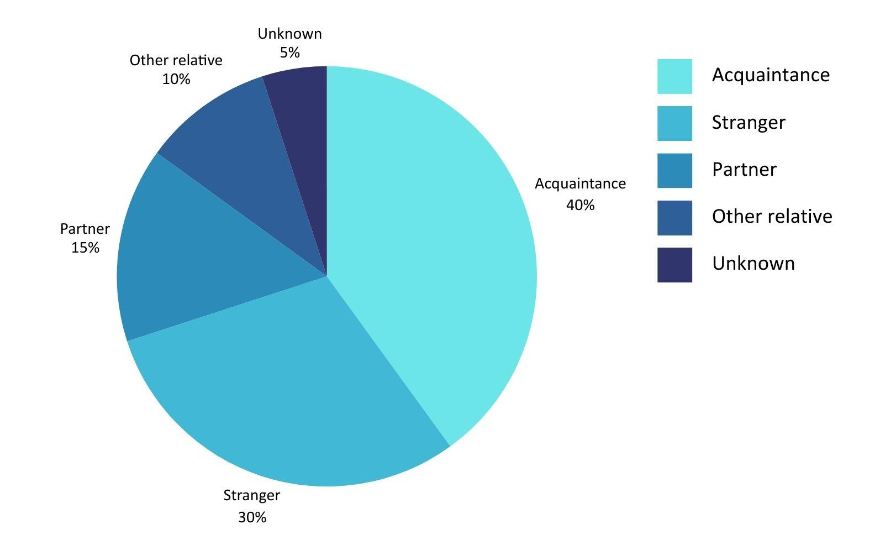
Relationship of victim to offender:
Violent victimization

Slide 19
Impacts of Abuse
Physical illness/worsening of medical conditions | Increased hospitalizations increase human and financial costs
Increased risk of death | Even moderate abuse increases risk by 300 percent
New &/or worsening behavioral health | Depression, Anxiety, PTSD, substance use
Isolation & loss of social contact | Loss of mobility, trust, home, this compounds other issues
Financial cost of exploitation | Ranges between $2.6 – 36.5 BILLION annually
Suicide risk is high, including passive suicide | The highest rate of suicide is in adults over 85, and 75-84
Loss of home, financial security, autonomy | Impacts of exploitation, injury, worsening of medical conditions

Slide 20
Preventing Abuse
Educate and Advocate
Build Protective Factors
Educate yourself about abuse
Educate clients about abuse
Build confidence in the client
Speak up when you see something
Take all disclosures seriously
Utilize advocacy groups
Promote a “no secrets” policy
Visit often, make your presence known
Stay engaged in the community
Access social services
Support primary caregivers
Stay as physically active as possible
Research caregivers and facilities
Pay attention to financial red flags
Access behavioral health
Utilize legal services early
Notes:
Types
1) Hostile ableism: This includes openly aggressive behaviors or policies, such as bullying, abuse, and violence.
2) Benevolent ableism: This form of ableism views people with disabilities as weak, vulnerable, or in need of rescuing.
3) Ambivalent: combination of the two/vacillating

Slide 21
HOW TO RESPOND
If you suspect abuse, ask! Many victims will not spontaneously disclose.
If a victim discloses, take it seriously.
Provide emotional support. Validate their experience and their feelings.
Assess the current risk & develop a safety plan. This may involve calling law enforcement, depending on the situation, & working with other providers.
Report immediately. Everyone is a mandated reporter. There are criminal penalties for failure to report.
Document everything – what the victim said, dates, who you spoke to & what they said.
Notes:
Safety plans – this could involve a change of location, medical care, psychological care. Law enforcement may be required in some situations.
FIGHT AGEISM AND NEGATIVE BELIEFS ABOUT PEOPLE WITH DISABILITES. BE AN ALLY FOR SOMEONE WHO CANNOT ADVOCATE FOR THEMSELVES!

Slide 22
NMAPS Three-pronged model
Cyclic in nature
Outreach, engagement & support
Always considering safety, autonomy & least restrictive interventions
PREVENTION
INTERVENTION
HARM REDUCTION

Slide 23
Prevention
Goal: intervene before a person becomes a victim
Emphasis: client education & resource identification
Not investigations – cases that do not meet criteria for investigations
Mitigating risk – attempts to reduce the contributing factors associated with abuse
Using Community Engagement Specialists – trained community health workers
Clinical Operations Unit – trained behavioral health advisors

Slide 24
Intervention
Beyond the typical investigation
Holistic approach to assessment
Complex
cases
Original allegations investigated​
New allegations added as revealed​
Cases remain open as long as necessary​
Frequent staffing, oversight and effective documentation
Functional
Medical
Social
Cognitive
Nutritional
Legal
**Capacity
Behavioral Health ​
Substance use/misuse ​
Complex family dynamics
​
Civil and criminal cases
Capacity concerns​
All staffed with Clinical Operations Unit ​
Notes:
Explain cyclic relationship between intervention and prevention.
**Capacity – explain how capacity is assessed and affects other parts of the investigation and model.

Slide 25
Harm reduction
What is harm reduction?
A set of practical strategies designed to reduce the risk of harm
Original application in drug/alcohol abuse setting
Principle is meeting people ”where they’re at”
Can be utilized in a variety of situations:
Drug & alcohol use/abuse
Hoarding
Medication management
Medical equipment and services
Level of care and directives
Nutrition
Caregiver stress management

Slide 26
MEDICAID REIMBURSEMENT
How it Works
HSD administers the State Medicaid program​
APS New Mexico is on our 4th year, aiding us to hire more workforce and increase pay equity​
Federal Government matches State expenditures to support “efficient and effective” administration of MEDICAID (typically 50%) ​
Random Moment Time Studies ​
Outreach, Facilitating Eligibility, Transportation, Translation, Program Planning/Policy Development/Interagency Coordination, Training, Referral/Coordination/Monitoring ​
Governmental Services Agreement (GSA)

Slide 27
REFERENCES
Administration for Community Living: https://acl.gov/​
Center for Disease Control and Prevention: https://www.cdc.gov/
​
Center for Disability Rights: https://cdrnys.org/​
National Coalition Against Domestic Violence: https://ncadv.org/
​
National Institutes of Health: https://www.nih.gov/​
Office for Victims of Crime: https://ovc.ojp.gov/​
US Census Bureau: https://www.census.gov/​
US Department of Justice: https://www.justice.gov/​
World Health Organization: https://www.who.int/ ​
Notes:
Let’s talk about WHY is this change being implemented?
First, New Mexico’s data collection processes were not compliant with the standards that the federal funding agency established.

Slide 28
THANK YOU!
Questions?
Contact:
Roberta.Farley@altsd.nm.gov
505-309-2360
Notes:
Denise

