Slide 1
NEW MEXICO AGING & LONG-TERM SERVICES DEPARTMENT
Aging and Disability Resource Center (ARDC) Resources for Independence in Aging
October 28, 2024
Kris Winterowd
CERD Bureau Chief – SHIP, SMP, and MIPPA Programs

Slide 2
OVERVIEW
By the end of this presentation, you will have:
Overview of Aging and Long-Term Services
Overview of ARDC Resource Center
Introduction to important consumer assistance programs SHIP and SMO
Overview of how Medicare works with IHS
2
Notes:
Courtney will be presenting the slides from #4 - #32
Assessments are at the core of identifying the needs of a consumer… As you know, an assessment is just a series of questions that providers/senior center staff use with their consumers to assess the needs of the folks being served, to determine care plans, and provide the information for folks to access services and the referrals to community resources.
Historically, each AAA has been able to use the assessment it deems best for their areas. WellSky has made available many different assessments for the use of the AAAs and their providers, unfortunately, this has led to inconsistent data collection.

Slide 3
Land Acknowledgement
We gratefully acknowledge the Native Peoples on whose ancestral homelands we gather, as well as the diverse and vibrant Native communities who make their home here today.
3

Slide 4
New Mexico ADRC Mission Statement
Serving all of New Mexico—connecting people with resources to maximize personal choice and independence.
Helping people understand their options, guiding them in the right direction, advocating on their behalf, and improving their quality of life in some way are basic concepts of the New Mexico ADRC.
Real People Real Answers Real Options
4

Slide 5
Options Counseling
Empower individuals to make informed decisions about Long-Term Services and Supports (LTSS)
Provide a clear pathway for individuals to access LTSS
Help individuals understand and obtain benefits for which they are eligible
Provide short-term assistance in connecting individuals to available services and supports
Make referrals to assist in resolving any issues
5
5

Slide 6
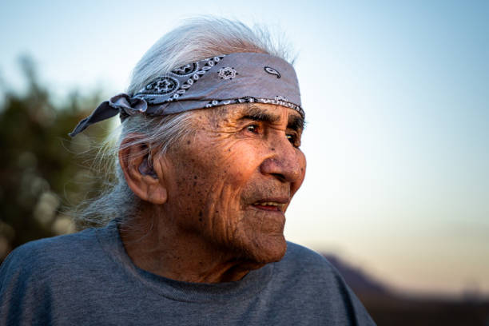
Home and Community-Based Services Waiver
Maintain the Central Registry for the Home and Community-Based Services Waiver
Educate callers on Medicaid benefits and services
Provide information on Managed Care Organization choices
Educate callers on Self-Directed waiver options
6
6

Slide 7
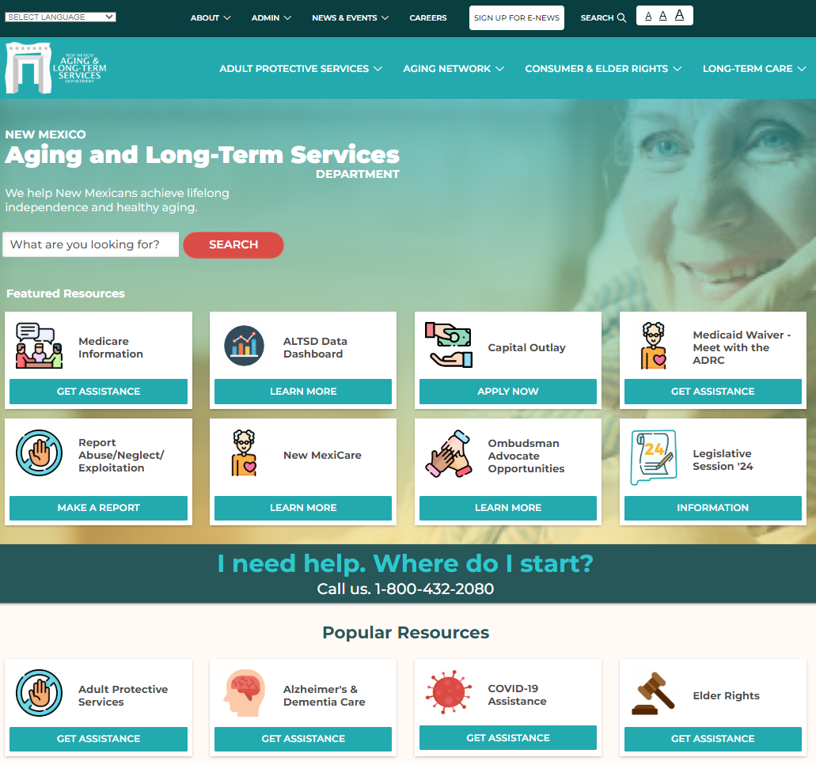
https://aging.nm.gov
7

Slide 8
Live Web Chat
Easily access information quickly online
Increase accessibility to the ADRC
Counselors available Monday – Friday 8:00 am to 5:00 pm
8

Slide 9
State Health Insurance Assistance Program (SHIP)
Provide answers to questions and concerns regarding private and government benefit programs
Offer one-on-one benefit counseling and assistance to people with Medicare and their families, including Original Medicare and Advantage plans, Supplemental plans, Medicare Part D, and Low-Income Subsidy Programs
Ensure that New Mexicans receive accurate, unbiased information about health care options and other entitlements
SHIP does not sell, endorse, or recommend any specific insurance or other health plan
9

Slide 10
Senior Medicare Patrol (SMP) Program
Health Care Fraud Prevention
Help Medicare and Medicaid beneficiaries avoid, detect, and prevent health care fraud
Help preserve the integrity of the Medicare and Medicaid programs
Educate and inform Medicare beneficiaries how to protect their personal identity, identify and report errors on their health care bills and identify deceptive health care practices, such as illegal marketing, providing unnecessary or inappropriate services and charging for services that were never provided
10

Slide 11
Prescription Drug Assistance
Provide individuals with information about pharmaceutical companies’ Patient Assistance Programs
Connect with resources that help pay for medications
Assist uninsured and under-insured individuals obtain the medications they need at a cost they can afford
11

Slide 12
Why Enroll in Medicare?
American Indians have a lower than average life expectancy and higher rates of many health issues
There are disparities in the access to health care and amount spent on care that contribute to negative health outcomes
In 2019 the per capita personal health care expenditure in the IHS user population was $4,078. In comparison, in 2017 the US national average was $9,726
12

Slide 13
Why Enroll in Medicare?
IHS is not health insurance. It is a part of the federal government that delivers health care to American Indians and provides funds for tribal and urban services
Medicare health insurance increases options for treatment and care
It protects the resources in the IHS system, enabling IHS to expand, enhance services, and help more people
13

Slide 14
Medicare 101
Medicare is health insurance for:
Adults 65 or older
Younger adults with certain disabilities
Anyone with End-Stage Renal Disease (ESRD)
Anyone with Amyotrophic Lateral Sclerosis (ALS)
14

Slide 15
How Part B benefits AI/AN Beneficiaries
Expanded access to primary care providers and specialists outside of IHS
Get covered services without IHS Purchased/Referred Care authorization
Get covered health care services when away from home service area
Avoid Part B late enrollment penalty
15

Slide 16
How Part D benefits AI/AN Beneficiaries
Expanded access to medications that may not be available through IHS
Get medication covered after hours and on weekends when IHS pharmacy is closed
Get covered medications when away from home service area
Avoid Part D late enrollment penalty
16

Slide 17
How Medicare benefits IHS:
Depending on the type of coverage, beneficiary may still get health care at IHS or local clinic, and the Indian health program can bill Medicare for care and prescriptions
Money saved by billing Medicare can be used to expand and improve services for the community
The IHS budget only meets about half of the need, so enrollment in Medicare helps expand needed care
17

Slide 18
Medicaid and Indian Health Services
IHS and CMS strongly encourage AI/AN to enroll in Medicaid
Adult MAGI
CHIP
Medicare Savings Program (MSP)
Home and Community-Based Waiver Programs for caregiving services
Any other program for which they might be eligible
Preserves resources and allows for expanded services
18

Slide 19
Medicaid Asset and Income Exclusions for American Indians/Alaska Natives
The following are NOT counted when determining eligibility for Medicaid and/or MSPs:
Indian Trust income
Individual Indian Money accounts
Real property within reservation boundaries
Natural resource interests within reservation boundaries
Items of traditional or cultural relevance
19

Slide 20
Get the Assistance You Need
Options Counseling
Low Income Programs
Information and Assistance
Healthy and Independent Living
Medicaid Turquoise Care (effective July 1, 2024)
SHIP expert Medicare information
SMP Medicare fraud information
Prescription Drug Assistance (PDA)
Community Information and Education
Web Chat
20
Notes:
Living longer means what?
Post pandemic behavioral health needs means what
How much money/how many years/ where in the state?

Slide 21
Other ALTSD Programs
Adult Protective Services
Long-Term Care Ombudsman
Area Agency on Aging
Office of Indian Elder Affairs
21

Slide 22
Want to learn more?
Visit the ALTSD YouTube channel for workshops, tutorials, and more at ALTSD New Mexico State - YouTube
22

Slide 23
FOR THE LATEST…
Follow us on Social Media
@newmexicoaging
Subscribe to e-news
https://aging.nm.gov/
receive-our-newsletter
23

Slide 24
ADRC Contact Information:
Offices in:
Santa Fe
Albuquerque
Las Cruces
Roswell
Farmington
800-432-2080
nmaging.nm.gov
nm.adrc@altsd.nm.gov
Notes:
Living longer means what?
Post pandemic behavioral health needs means what
How much money/how many years/ where in the state?

Slide 25
Your feedback is important to us
Customer Satisfaction
Please complete a brief survey at: www.surveymonkey.com/r/ACLED
25

Slide 26
Thank you
Kris Winterowd CERD Bureau Chief – SHIP, SMP, and MIPPA Programs
Notes:
Denise

