Slide 1
NEW MEXICO AGING & LONG-TERM SERVICES DEPARTMENT
Making the Most of Medicare
October 28, 2024
Kris Winterowd
CERD Bureau Chief – SHIP, SMP, and MIPPA Programs

Slide 2
Land Acknowledgement
We gratefully acknowledge the Native Peoples on whose ancestral homelands we gather, as well as the diverse and vibrant Native communities who make their home here today.
2

Slide 3
OVERVIEW
Today we will discuss:
What is SHIP/SMP
Understanding Medicare
What Beneficiaries Can Do During Medicare Fall Open Enrollment
Fraud Red Flags
Aging & Disability Resource Center (ADRC) Fall open enrollment hybrid counseling
3
Notes:
Courtney will be presenting the slides from #4 - #32
Assessments are at the core of identifying the needs of a consumer… As you know, an assessment is just a series of questions that providers/senior center staff use with their consumers to assess the needs of the folks being served, to determine care plans, and provide the information for folks to access services and the referrals to community resources.
Historically, each AAA has been able to use the assessment it deems best for their areas. WellSky has made available many different assessments for the use of the AAAs and their providers, unfortunately, this has led to inconsistent data collection.

Slide 4
New Mexico SHIP: State Health Insurance Assistance Program
Federal Partnership
Counseling
Education
Outreach
Free and Unbiased
People on Medicare
Family members
Caregivers
4
Notes:
Living longer means what?
Post pandemic behavioral health needs means what
How much money/how many years/ where in the state?

Slide 5
New Mexico smp: Senior Medicare Patrol Program
Federal Partnership
Counseling and Advocacy
Education
Community Outreach
Protect, detect and report health care fraud
Serving Medicare and Medicaid beneficiaries
Caregivers
5
Notes:
We are the sister program to SHIP. This is the part of the department that helps prevent, detect and report Medicare fraud, waste, and abuse.
We have a Federal partnership with CMS the Centers for Medicare and Medicaid Services to provide advocacy, education, and outreach.
Now that we’re getting into Medicare open enrollment, you may have been approached about your Medicare or asked for your information. You want to be careful about that. We’ll talk more about that later in the presentation.

Slide 6
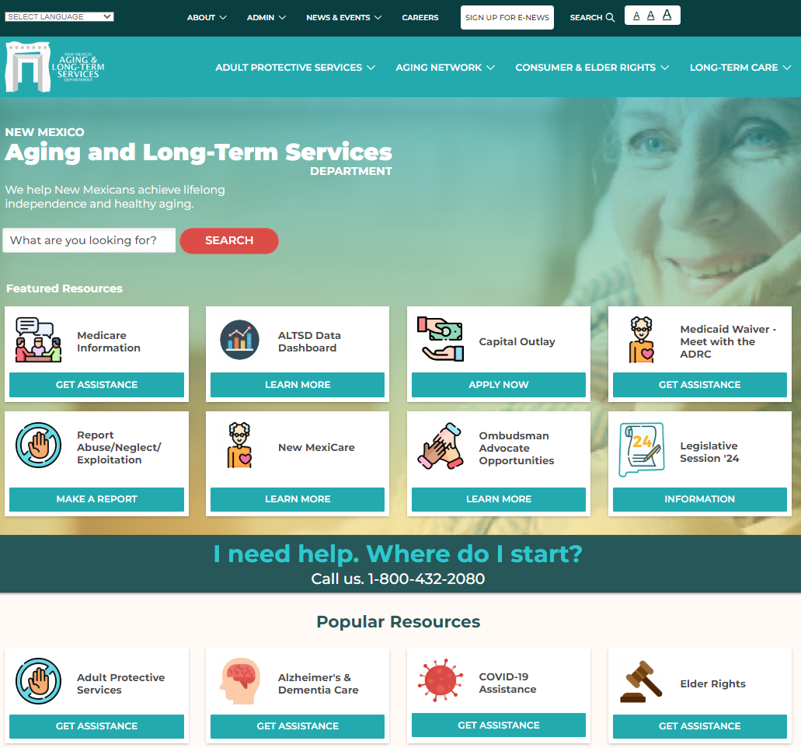
https://aging.nm.gov
6

Slide 7
Understanding Medicare

Slide 8
Medicare Options
Original medicare
Medicare advantage
Part A
Inpatient
Part B
Outpatient
Part C
A + B (usually) D
Some Advantage plans don’t offer prescription coverage
Part D
Prescription
Medigap
Pays 20%
8

Slide 9
Find information online at www.medicare.gov
9

Slide 10
Changes Coming to Medicare 2025
$2,000 cap on out-of-pocket prescription drug costs
New Prescription Payment Plan option
For those with Extra Help or Medicare Savings Program:
Can change prescription drug plan monthly (not quarterly)
Can change from Advantage to Original by enrolling in Part D plan
Can no longer change from Original to Advantage outside Open Enrollment
Can only change Advantage plans during MAP SEP or fall Open Enrollment
10

Slide 11
What Beneficiaries Can Do
During Open Enrollment

Slide 12
Prepare for Open Enrollment
Carefully review current plan
Read Annual Notice of Change (ANOC) and/or Evidence of Coverage (EOC)
Think about changes to your health in the past year and your upcoming health needs
Explore plans using Plan Finder on Medicare.gov website
Call the ADRC at 1-800-432-2080 for information and assistance
12

Slide 13
During Open Enrollment - Options
Change from Original Medicare to a Medicare Advantage Plan.
Change from a Medicare Advantage Plan back to Original Medicare.
Switch from one Medicare Advantage Plan to another Medicare Advantage Plan.
Switch from a Medicare Advantage Plan that doesn’t offer drug coverage to a Medicare Advantage Plan that offers drug coverage.
Switch from a Medicare Advantage Plan that offers drug coverage to a Medicare Advantage Plan that does not offer drug coverage.
Join a Medicare Prescription Drug Plan.
Switch from one Medicare Prescription Drug Plan to another Medicare Prescription Drug Plan.
Discontinue Medicare prescription drug coverage completely.
13

Slide 14
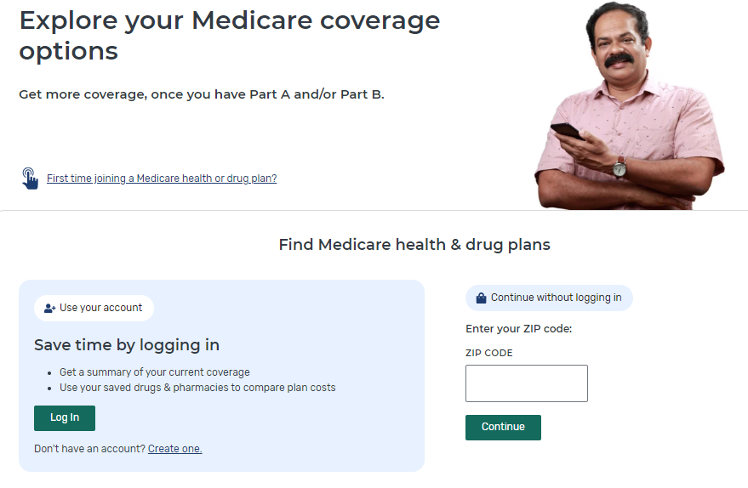
Visit www.medicare.gov and Select “Find Plans Now”
14

Slide 15
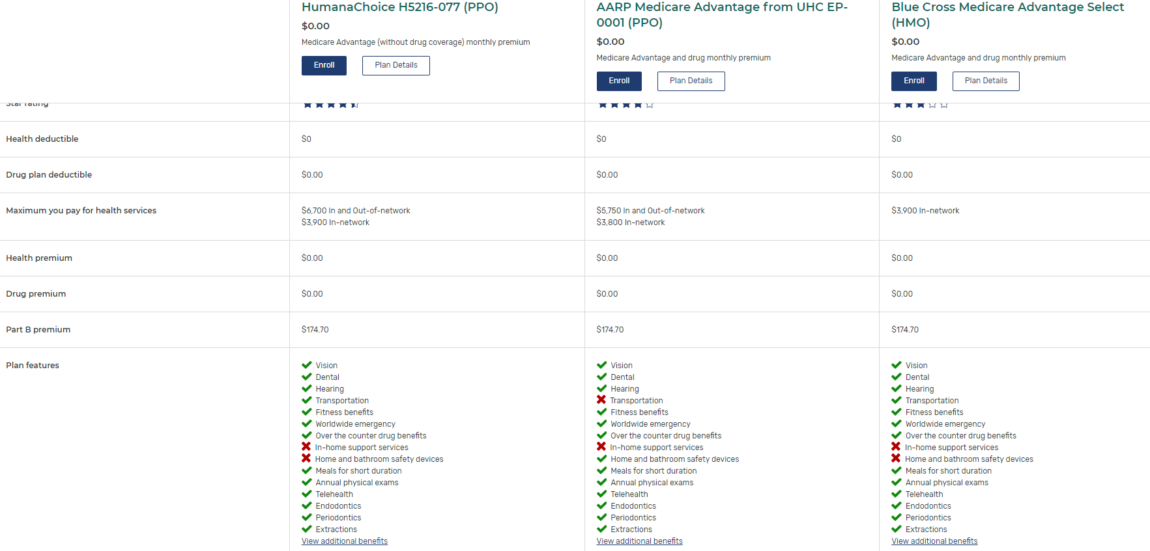
Compare Plan Information Side-By-Side
15

Slide 16
Considerations When Choosing New Plan
Are your Providers in-network?
Are your drugs on the plan’s formulary?
Is your pharmacy a preferred pharmacy for the plan?
What additional benefits are offered by the plan?
How will changing plans effect your costs?
16

Slide 17
Protect Yourself from Medicare Scams During Open Enrollment Sign up for Scam Alerts at www.aging.nm.gov
17
Notes:
We’re in the season of Medicare advertisements. A lot of the advertisements out there are misleading. You can sign up for scam alerts on our website aging.nm.gov.
Go to the home page
Scroll about halfway down the page to the Popular Resources section shown here
Select the Receive Scam Alerts tile to sign up

Slide 18
Fraud Red Flags During Open Enrollment
Plans are allowed to send you emails and/or direct mailings.
Plans that send e-mails must provide an opt-out option for people who no longer wish to receive them.
Plans are not allowed to send unsolicited text messages or call you or visit you in person to market their products without your permission.
Notes:
Plans are allowed to send you emails and/or direct mailings. It’s advertising. What you should do if you have questions is, call us. We are the place to go for official unbiased information. Don’t stress out about them. That is why we are here. They are allowed to send them to you, you are not required to look at it. Call us, and then throw them in your paper shredder.
* There are rules for the emails. Plans are allowed to send emails, but they must provide an opt-out option. I’m leery of emails with links. Know if you see these emails, this is a requirement.
* Plans are not allowed to send unsolicited text messages, or call you or visit you in person to market their products without your permission.
+Be careful if you are at any kind of event and if there is an insurance company representative there. Be very careful about what you sign. Make sure you know what it is. Even if it is a sign in sheet. You could be exposing yourself to solicitation.
* Plan representatives cannot approach you in public areas, such as a parking lot, hallways, or sidewalks.
* Plan representatives are not allowed to charge a fee to enroll you in a Medicare Advantage plan. There is a premium, but no fee to enroll.

Slide 19
Disengage Immediately if Anyone:
Pressures you to join their plan
Tells you they represent Medicare and want to offer you a service for free
Claims you are missing out on entitled plan benefit
Offers health screenings or other activities that may be perceived as / used for ‘cherry-picking’ Medicare beneficiaries only
Requires contact information at an event for a plan (for anything other that raffle purposes
Informs you that you will lose your Medicare benefits unless you sign up for a certain plan
Notes:
When should you walk away?
Read slide.
1 You can use the entire Open Enrollment Period to make your decisions. You will not receive extra benefits for signing up early.
Remember they can’t contact you without your permission. Be careful about giving out your information. You could be giving permission.
Always call us for official unbiased information.

Slide 20
Fall Open Enrollment In-Person and Telephone Counseling
Source: https://www.medicareinteractive.org/get-answers/medicare-fraud-and-abuse/
20

Slide 21
In-person events in many communities, call ADRC for info
Use Beneficiary Planning Tool
ADRC – Live or callback assistance
SHIP appointments – appointments scheduled starting October 1, 2024
2024 Fall Open Enrollment Counseling
1-800-432-2080
21

Slide 22
Basic demographic information
Drug list and dosages
Designed to support a smooth and efficient experience
Beneficiary Planning Tool for Remote Counseling
22

Slide 23
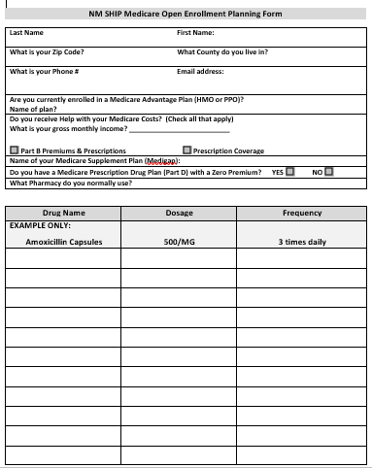
NM SHIP Open Enrollment Planning Form
23

Slide 24
Open Enrollment Q&A

Slide 25
ADRC Contact Information:
Offices in:
Santa Fe
Albuquerque
Las Cruces
Roswell
Farmington
800-432-2080
nmaging.nm.gov
nm.adrc@altsd.nm.gov
Notes:
Living longer means what?
Post pandemic behavioral health needs means what
How much money/how many years/ where in the state?

Slide 26
Other ALTSD Programs
Adult Protective Services
Long-Term Care Ombudsman
Area Agency on Aging
Office of Indian Elder Affairs
26

Slide 27
FOR THE LATEST…
Follow us on Social Media
@newmexicoaging
Subscribe to e-news
https://aging.nm.gov/
receive-our-newsletter
27

Slide 28
Your feedback is important to us
Customer Satisfaction
Please complete a brief survey at: www.surveymonkey.com/r/ACLED
28

Slide 29
THANK YOU
Notes:
Denise

