Slide 1
New Mexico Caregiver Respite Training & Registry Adrienne Smith, President & CEO June 22, 2024
October 28, 2024
Notes:
Intro self
Audience Intro if less than 20
More that 20 ask the following:
How many are unpaid family caregivers
Paid family caregivers
Work for a caregiving agency or facility
Provide Respite Care for Caregivers
Have completed Respite Care Certification
Are listed in the state respite providers registry

Slide 2
Agenda
10:05 am Welcome and Introductions
10:10 am NM Caregivers Coalition
10:10 am Respite Care Overview
10:40 am How to Refer to Respite Care
10:50 am Q & A
11:00 am Next Steps
11:05 am Adjourn

Slide 3
Who Are We?

Slide 4
Finding out what caregivers need
Listening Sessions held across state to identify challenges and solutions
Intentional decision that the caregiver is the organizational voice
Notes:
ARS

Slide 5
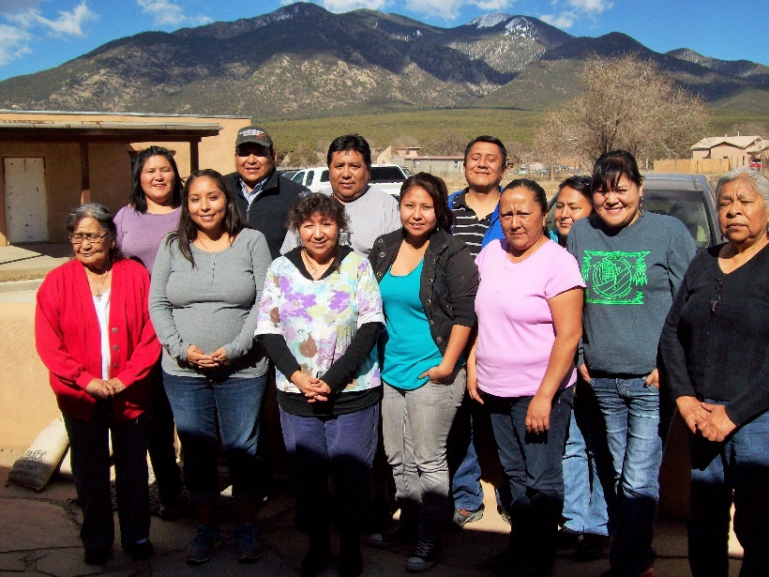
How Do We Support Caregivers?

Slide 6
Created by the Federal Reserve for:
Job-seekers
Human Resource Professionals
Policymakers
https://www.nmdcc.org/public-assistance-benefits-test/

Slide 7
Respite Provider Certification
Infection Prevention
Safe Transfer and Mobility
Communications Skills
Financial Literacy
Navigating Medicare
Training is provided at no cost to caregivers. https://www.nmdcc.org/training-for-caregivers/

Slide 8
Caregivers are the Backbone
Who is a caregiver?
If you are helping a spouse, relative, friend or neighbor with some of their activities of daily living, then you are a caregiver.
Caregivers are the backbone of the long-term care system providing assistance and support to those who need help.
80% of those needing long term services and supports live at home and the care most often falls to a family member

Slide 9
Are You a Caregiver?
Help with paying bills
Help with shopping, cooking, laundry or home maintenance
Help with personal care (dressing, bathing, feeding, toileting)
Help moving around the house or outside the house (transportation)

Slide 10
Are you a Caregiver?
Help with taking medications
Help with making or receiving phone calls
Help arranging or coordinating services outside the home
Companionship through personal visits or by telephone

Slide 11
Effects of Caregiving
1 out of 4 caregivers have had a decline in health
1 of 5 report high physical strain from caregiving
4 of 10 caregivers consider caregiving to be highly stressful
National Alliance for Caregiving, 2020

Slide 12
What Is Respite?
Planned or emergency care
provided to a child or adult with special needs
in order to provide temporary relief to family caregivers who are caring for that child or adult.
Lifespan Respite Care Act definition PL 109-442

Slide 13
Respite = Short Break
How long is a short break?
Where does Respite take place?
How often should respite be available?
Why does a short break matter?

Slide 14
Who Needs Respite?
Family Caregivers who care for loved ones living with:
Intellectual/developmental disabilities (I/DD)
Brain Injuries
Emotional/behavioral disorders
Physical Disabilities
Neurological disorders
Memory impairments
Unlike other healthcare workers, their shifts are 24/7

Slide 15
Things Caregivers Can Do During Respite Care
Rest and take a nap
Read a book
Watch TV
Attend their own medical and health appointments
Attend a support group
Go for a walk
Run errands
Spend time with family or friends
Exercise
Take a vacation

Slide 16
Benefits of Respite
Reduce Stress
Improve Physical and Emotional health
Build Relationships and Reduce Social Isolation
Care Recipients Benefit Too!

Slide 17
Respite Benefits Everyone!
53 million family caregivers of an adult or child with a disability of chronic condition in the U.S.
Estimated economic value: $600 billion per year
86% of family caregivers of adults do not use respite
Of those who do, they often receive help too little, too late

Slide 18
Respite: Most Effective Early Often Too Little To Late
Cost
Shortage of qualified providers
Don’t feel comfortable using respite or identifying as a caregivers
Access
Multiple funding streams with confusing requirements
Lack of information

Slide 19
How to pay for Respite Care
Insurance- varies by plan
Grant Funded
Self-Funded

Slide 20
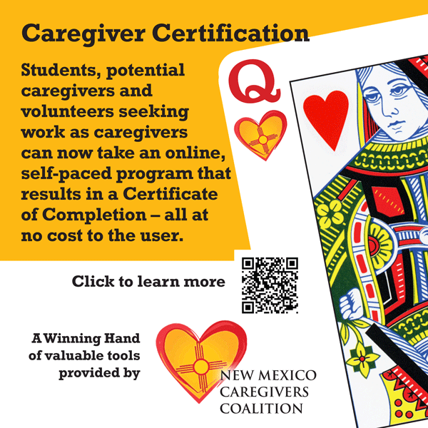
Respite Caregiver Certification
For students, retirees and job-seekers who want to work as respite caregivers
Online or App
Self-paced
No Cost to student
Staff Support for Student Success
Certificate of Completion
Eligible for Registry Profile
https://newmexico-respitecarewi.talentlms.com/index
Notes:
ARS

Slide 21
Next Steps
Register for Respite Providers Training
https://newmexico-respitecarewi.talentlms.com/index
State Respite Provider Registry
https://respiteregistrynm.org/

Slide 22
Let’s Look Around
Caregiver Certification
https://www.nmdcc.org/caregiver-certification/
What are the Core Competencies of Certification? https://archrespite.org/library/respite-professional-core-competencies/
Where is the training portal? https://newmexico-respitecarewi.talentlms.com/
What about the Respite Care Registry?
Other Resources for family and respite caregivers: https://archrespite.org/
Hear from others about what being a respite care provider means to them: https://drive.google.com/file/d/1R6G_ePLDETi5OZv4OcxliYzmB5O6WOQG/view

Slide 23
Thank you!
New Mexico Caregivers Coalition
Ph. 505-867-6046
www.nmdcc.org
info@nmdcc.org
For a training demonstration or for questions on Respite Care
Sharon Finarelli, Respite Care Manager
Sharon@nmdcc.org
Ph. 575-621-9684
NMCC advocates for direct care workers’ education, training, benefits, wages
and professional development so they may better serve people who are elderly
and those with disabilities.

