Slide 1
Sectors of Success:
Aging to 100 in New Mexico
Roberta Farley, MA, CCHW
Clinical Operations Manager – Adult Protective Services
New Mexico Aging & Long-Term Services Department

Slide 2
Objectives
By the end of this presentation, you will:
Better understand the concept known as the “Graying of America”
Have a clear understanding of the challenges, ethical considerations, and potential solutions
Understand The Blue Zones® and why they are important
See how New Mexico is dedicated to healthy aging to 100 and beyond

Slide 3
“The Graying of America”
Refers to the increase in the percentage of older adults in the U.S.
U.S. Census Bureau projects people over 65 will outnumber children by 2034
77.0 million; 76.5 million, respectively
Due to lower fertility rate and longer life expectancy
There will be significantly more women than men due to women generally living longer
Baby Boomer Generation
One of the largest generations
in U.S. history
All BBs will be older than 65 by 2030, comprising 21% of the population
Notes:
https://www.census.gov/library/stories/2018/03/graying-america.html – article citation and source.
Previously projected for 2035, now corrected to 2034 – recalculated due to an error in infant mortality rates. Now one year earlier than thought due to recalculation of child mortality rates.
“THE GRAYING OF AMERICA”
Lower fertility rate is associated with younger generations choosing not to have children, delaying becoming parents until older, and having less children on average.
Life expectancy in the US is 74 for males currently, 80 for females, 77.5 both sexes. Hence why more females than males.
BABY BOOMERS
This is a significant increase in the amount of older adults in the population
Older adults defined as 65+

Slide 4
Two Centuries of Population Change in the U.S.
Notes:
From pyramids to pillars: TWO CENTURIES OF POPULATION CHANGE IN THE U.S
US census video.
In this video, they are talking about much older adults in the year 2060 (people in their 80’s) making up about 8% of the population. But if we define older adults as 60+, then this happens in 2034 like the previous slide stated.

Slide 5
Projections
International migration will overtake birth rate as the driving force of population growth.
Immigration trends will shift from Latin American to Asian countries.
1/4 Americans will be 65 and older.
The number of people over 85 will triple and become the fastest growing age group.
We will add half a million centenarians.
By the year 2060:
By the year 2030:
The U.S. will cross the 400 million mark
Year 2058:
Notes:
Immigration trends: historically the working population of immigrants has been heavily from Latin American countries. This pattern has been shifting and we are seeing much more immigration from Asian countries such as China.
This trend is projected to continue and the shift will occur in 2030. This is important as we look at immigration policy and who will be working age during these future decades.
- Much of our working population will be immigrants since that force of growth is and will be larger than our birth rate.

Slide 6
Around the Globe
7.9 billion people
live on Earth.
61% in Asia,
mostly in China
and India.
Only 4.5% in the U.S.
The world
population
will rise to 9.3 billion by 2050.
U.S. is aging faster than most.
Japan currently holds the record.
By 2050, people > 65 will reach 40%.
Germany - 30%
Italy - 31%
Canada - 26.5%
Russia – 26%
Notes:
https://www.ncbi.nlm.nih.gov/pmc/articles/PMC4501019/
https://socialsci.libretexts.org/Bookshelves/Human_Development/Lifespan_Development_(Lumen)/10%3A_Late_Adulthood/10.04%3A_The_Graying_Population_and_Life_Expectancy
7.9 billion people on earth (give or take). In about 15 years, we will add over 2 billion people (second statistic). The US population is aging faster than most other countries.
This explains why the immigration pattern is shifting to Asian countries – they are over populated. “Has anyone every been to India here?”
Japan holds the record as the country aging the fastest. By 2050, people over 65 will make up 40% of Japanese population. Japan is known for their reverence for older adults and for how they care for their aging population, so this is not a surprise.
Final stat is various countries rates of older adults by the same time as a comparison.

Slide 7
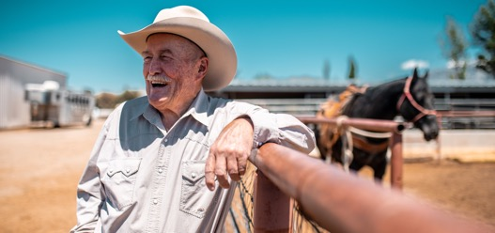
Challenges
Decline in working-age population
Possibility of shortage of qualified workers, declining productivity, high labor cost, delayed business expansion, pushing up of wages/inflation
Increase in dependency ratio
Government benefits are funded by shrinking pools of workers.
Lower tax revenue with higher spending on Social Security, etc…
Changes to the economy
Age is a factor in how people spend money. Transitioning goods and services to older adults may be challenging.
Increasing healthcare
costs
Related to labor issues, includes struggles to
find caregivers,
staffing facilities, providers with geriatric specialties, increased cost to consumers.
Notes:
Decline in working age
More difficult to fill in-demand roles, declining productivity, high labor cost, delayed business expansion, reduced international competitiveness, pushing up of wages leading to inflation, some look to immigration to solve this
Increase in Dependency Ratio
-lower tax revenue with higher spending on pensions, SS, medical care as the ratio changes
Changes to the Economy
Greater demands for healthcare services and retirement homes, for example. May be challenging to transition to good and services focused for older adults.
Increased health care cost
-same labor issues to fill jobs, including in-home care (already seeing this)

Slide 8
Ethical Considerations
Ageism
Social competition; “Us versus them”
When one group appears to be using most of the resources
Fuels negative thinking
Can lead to discrimination & violence against certain groups
Healthcare Rationing
Callahan, Setting Limits: Medical Goals in an Aging Society
Assumes that the lives of older adults are less valuable than the young
Should use an “adjusted quality of life”
Medicare/healthcare for older adults should be palliative, not curative
Access to insurance
Benefits may change, become more expensive or become harder/impossible to get
Financial insecurity
Proposals to raise Social Security and Medicare age requirements
Already happening here & other countries
Notes:
https://www.ncbi.nlm.nih.gov/pmc/articles/PMC4501019/
Ageism
Sociological competition – us versus them. When one group appears to be using up much of the resources, this makes other groups nervous and fuels negative thinking about that group creating the us versus them mentality. May lead to violence and abuse of certain groups.
Health care rationing (Callahan, Setting Limits: Medial Goals in an Aging Society)
Assuming the lives of older adults are less valuable than the young – he argued that Medicare should focus on palliative care as opposed to curative in older adults. We should do this using an “Adjusted QOL” – basically at a certain age, what treatment you get is already decided for you since your life is not as valued. This is a scary notion, that our age will be the primary factor to determine what care we are given (not our choice).
Access to insurance
Benefits may change, become more expensive, harder/impossible to get. An example: the older you get, the more it costs to buy insurance (the premiums are much higher regardless of your health status).
Financial insecurity
Proposals to raise the Social Security and Medicare age requirements are already happening. Take France for example. We have already raised the Medicare/SS age. First it was raised from 65 to 66, and is now is scheduled as age 67 for anyone born after 1960. There is discussion about raising this to 70 in the year 2040.

Slide 9
Responses and Solutions
Business Practices
Attitudes about older adults must change
Allow flexibility in schedules, duties and telecommuting
Continuous training emphasizing new skills
Invest in worker healthcare
Move away from seniority-based pay systems and toward performance
Public Policy
Incentivize retiring older (60-65)
Reform tax and benefit policies to encourage prolonged careers
Replace mandatory retirement ages with ability-based practices
Utilize working-age immigrants
Incentivize volunteering
Invest in technology and tech skill training
Notes:
https://www.hsph.harvard.edu/wp-content/uploads/sites/1288/2013/10/PGDA_WP_71.pdf
Public Policy
Incentivize retiring older (60-65). Can be done through tax incentives – for example, higher tax breaks and credits for those who are working older.
Reform tax and benefit policies to encourage prolonged careers. Within government agencies as well – incentivize them staying longer at work.
Replace mandatory retirement ages (often arbitrary) with ability-based practices. Many fields have a mandatory retirement age (LE is a good example). Often these workers can still do the job.
Utilize working-age migrants. Develop policy for migrant workers to legally work here and pay into the system since we will rely heavily on their contributions.
Incentivize volunteering – perhaps tax cuts, etc.. to encourage older retired adults to still participate in a work-force
Business Practices
Attitudes about older adults must change – ageism is a real problem in the workplace. Need to shift our thinking away from just hiring “young blood.”
Allow flexibility in schedules, duties and telecommuting. As we age, we may have mobility issues, medical concerns. By accommodating people we keep them in the workforce to do the things they are still able.
Continuous training emphasizing new skill acquisition – As we are in a job a long time, we often stop learning new skills. Encourage new learning to stay in workforce.
Invest in worker healthcare – a small investment could really pay off. Employer sponsored clinics, free telehealth, vaccine clinics at the job site, etc.
Move away from seniority-based pay systems and toward performance-based – stop paying people more for being there a long time and focus on performance. Seniority means nothing if your work is sub-par.

Slide 10
Healthcare Solutions: Remediate Disparity
Internet? Appropriate devices?
Need help to utilize?
Practice visits? Digital monitoring?
Conduct more research and trials!
Track developing medical conditions
Prevention, Education & Geroscience
Digital transformation
Address know clinical issues
Large print-materials
Assistive devices
Better facility maps & signage
ADA modifications
Strengthen public health
Create a qualified aging workforce
Redesign long-term facilities & supports
Shift to patient-centered palliative care
Facility improvements
Healthcare reform
Notes:
https://www.wolterskluwer.com/en/exphttps://
www.healthstream.com/resource/articles/solutions-to-care-for-an-aging-populationert-insights/addressing-healthcare-costs-of-an-aging-population-through-digital-transformation
https://www.healthaffairs.org/doi/10.1377/hlthaff.2020.01470
Digital transformation
Many people still do not have access to AFFORDABLE reliable internet. Need devices appropriate for older adults who may have disabilities (closed captioning), speech to text, etc.. Does the consumer need help using the technology. Can doctors help them learn how to do their telehealth visit? Virtual caregivers, monitoring?
Facility improvements – many providers still don’t have these things.
Address know clinical issues – research trials usually don’t include people of advanced age. This needs to change if we want to provide proper care to this growing population. Health care needs to do better at tracking symptoms of new developing conditions know in that population. Focus should be on preventing these conditions, educating patients, and the field of Geroscience.

Slide 11
BLUE ZONES ®
Barbagia Region of Sardinia – mountain highlands
*Highest known concentration of males > 100
Ikaria, Greece – Aegean Island
*2nd lowest rate of middle age mortality & lowest dementia
Term coined by:
Dan Buettner, National Geographic Explorer and Fellow (2004).
After an expedition to Okinawa, Japan, he made a mission of
exploring other regions of the world with high longevity.
Nicoya Peninsula, Costa Rica
*Lowest rate of middle age mortality, high rate of males > 100
Seventh Day Adventists – largest numbers near Loma Linda, CA
*Live 10 years longer than their North American counterparts
Okinawa, Japan
*Females over 70 are longest-lived population in the world
Notes:
https://www.bluezones.com/
This is all based on research across these populations. Strict Metanalysis research was conducted and this is where the factors emerged.
https://www.ncbi.nlm.nih.gov/books/NBK298903/

Slide 12
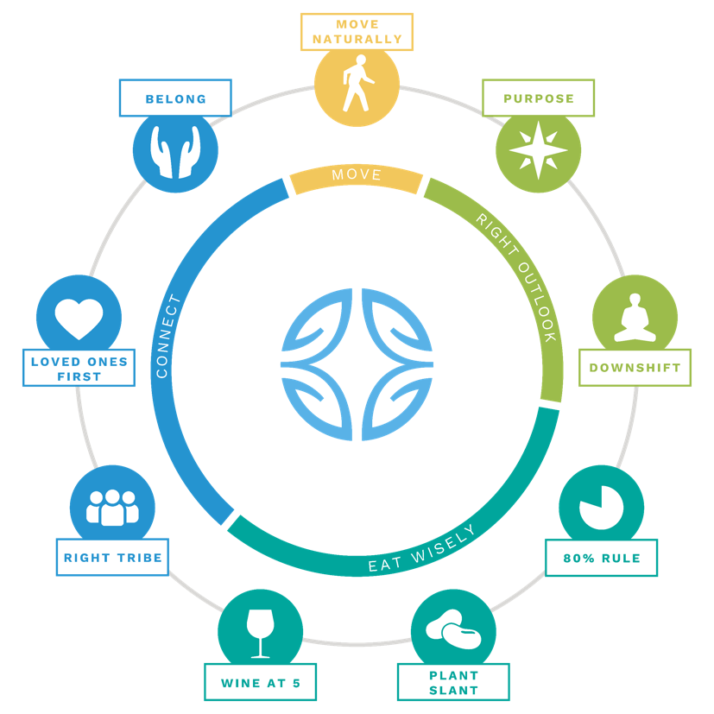
Power 9 ®
Reverse engineering Longevity
Move Naturally: gardening, walking
Purpose: “why I get up in the morning”
Downshift: routines to shed stress
80% Rule: stop eating when 80% full
Plant Slant: high legumes/veggies, low meat
Wine at 5: moderate regular alcohol (1-2)
Right Tribe: small groups of lifelong friends
Loved Ones First: family first, including aging
Belong: Faith based community (any faith)
Notes:
The Danish Twin Study established that only 20% of longevity is determined by genes. (https://pubmed.ncbi.nlm.nih.gov/8786073/)
Move Naturally: gardening, walking – not working out, but doing natural exercise, manual lawn mowers, chopping wood
Purpose: “why I get up in the morning” – knowing your sense of purpose will add up to 7 years to your life
Downshift: routines to shed stress - everyone has stress – leads to inflammation, etc.. – take a few moments every day to pray, remember ancestors, meditate, take a nap, happy hour, DAILY
80% Rule: stop eating when 80% full – the 20% gap can be the difference between losing an gaining weight.
Plant Slant: more beans/legumes, less meat – high bean diet for protein (fava, black beans, lentils, etc.. ). Meat, mostly pork only eaten 5X per month in serving of 3-4 ounces
Wine at 5: moderate regular alcohol (1-2) – everyone except Seventh Day Adventists – 1-2 glasses per day (usually wine) normally with friend. No saving it up. ☺
Right Tribe: small groups of lifelong friends – social circles that support healthy behaviors (smoking, obesity, happiness and even loneliness can be contagious (research) so your circle matters.
Loved Ones First: family first, including aging – family comes first over everything else. This means caring for aging parents and grandparents. Invest in children so they will invest in you.
Belong: Faith based community (any faith) – all but 5 out of 263 Centenarians interviewed belonged to a faith. Having regular faith based activity can add 4-14 years to you life. (Any faith). Volunteering is also known to raise longevity.

Slide 13
New Mexico Demographics
A little over 2,114,000 people are estimated to live in New Mexico
19.8% are people over the age of 65
21.3% are less than 18 years old
5.1%
are less than 5 years old
9.2 % are foreign born persons
About 50/50 male to female ratio
Females (50.3%)
https://www.census.gov/quickfacts/table/PST045215/35
Notes:
These are projection from US Census taken on July1st, 2024.
I could not include the total of people living with disabilities because they only included people under 65 in the disability numbers. This is an underestimate.
Foreign born does not indicate their residency or citizenship status.
Not clear how “male/female” was calculated and there is only this dichotomy (this is “sex” not gender). It is assumed like other models that this is based on sex assigned at birth.

Slide 14
New Mexico aging services
Highlighted Programs & Services
Older Adult
Community
Health Workers
Care Transitions
Clinical Operations Unit
New Mexicare
Pen Pal Program
Notes:
https://www.ncbi.nlm.nih.gov/pmc/articles/PMC4501019/
Ageism
Sociological competition – us versus them. When one group appears to be using up much of the resources, this makes other groups nervous and fuels negative thinking about that group creating the us versus them mentality. May lead to violence and abuse of certain groups.
Health care rationing (Callahan, Setting Limits: Medial Goals in an Aging Society)
Assuming the lives of older adults are less valuable than the young – he argued that Medicare should focus on palliative care as opposed to curative in older adults. We should do this using an “Adjusted QOL” – basically at a certain age, what treatment you get is already decided for you since your life is not as valued. This is a scary notion, that our age will be the primary factor to determine what care we are given (not our choice).
Access to insurance
Benefits may change, become more expensive, harder/impossible to get. An example: the older you get, the more it costs to buy insurance (the premiums are much higher regardless of your health status).
Financial insecurity
Proposals to raise the Social Security and Medicare age requirements are already happening. Take France for example. We have already raised the Medicare/SS age. First it was raised from 65 to 66, and is now is scheduled as age 67 for anyone born after 1960. There is discussion about raising this to 70 in the year 2040.

Slide 15
OLDER COMMUNITY HEALTH WORKER PROGRAM
Innovative collaboration between NM ALTSD, NM Department of Health (Office of Community Health Workers), and UNM Community Health Workers Initiatives.
Older adults (55+) are recruited and trained as Community Health Workers (CHWs).
CHWs are frontline workers who focus on social factors of care. They use their knowledge of the community, connections and public education to overcome systemic barriers to better address health and social needs.
tinyurl.com/2fb246ej

Slide 16
New Mexicare caregiver health model
Prevention oriented program, provides financial support & training to family/friends providing services.
Community Engagement Specialists assist to develop and monitor individuals plans.
Applicants must:
Be 60 or older,
Need assistance with at least two ADLs
Caregivers required to received 12 hours annual training and criminal background check.
Compensation is up to $1400/month
https://aging.nm.gov/protecting-adults/newmexicare
Notes:
Eligibility requirements are as follows:
Applicant must be age 60+​
Have cognitive or physical limitations requiring assistance with two or more activities of daily living such as: feeding, dressing, personal hygiene, incontinence, toileting, and/or ambulating (walking)​
Cannot be eligible for Medicaid​​
Maximum Gross Income Level
Up to $3,387/Mo for Individuals
Up to $6,774/Mo for Couples​​
​​
Resource Level​​ (total for savings plus checking accounts)​​​
Up to $20,322/Mo for Individuals
Up to $40,644/Mo for Couples
After you apply:
A Community Engagement Specialist will contact the applicant to conduct an in-home assessment – this may take up to 30 business days depending on the number of applicants.
If eligible, you may receive up to $1,400 for up to 12 months to assist with paying caregiver(s) who provide homecare, respite/daycare, transportation, and home health & safety monitoring services.
The maximum monthly allotment is $1,400.
The Community Engagement Specialist will assist with the development of an individualized service plan.
All caregivers must complete a criminal background check which may take up to 10 business days.
Caregivers will be required to attend 12 hours of on-line training per year.
Cannot be eligible for Medicaid​​
Maximum Gross Income Level
Up to $3,387/Mo for Individuals
Up to $6,774/Mo for Couples​​
Resource Level​​ (total for savings plus checking accounts)​​​
Up to $20,322/Mo for Individuals
Up to $40,644/Mo for Couples

Slide 17
Special APS Programs – Harm Reduction
Care Transitions (CT)
Helps residents transfer from a long-term care facility into the community.
CT works with individuals, families, facilities, and guardians through the transition process.
CT assists with housing, assistance programs, public education & other resources to ensure a safe transition into the community.
Clinical Operations (CO)
Serve as the Department’s behavioral health (BH) consultants on complex cases.
Provide quality assurance support: reviews of deaths, substantiations & high-level reviews. Conducts training on BH topics.
CO consults/provides direct services for cases involving mental illness, substance misuse, cognitive impairments and other complex family dynamics.

Slide 18
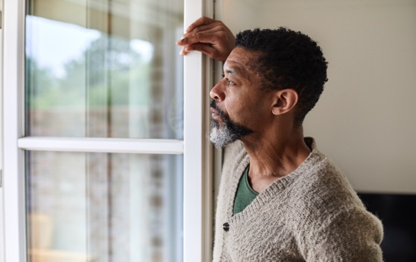
Reducing loneliness & Risk
National Institutes of Health
Research indicates that in adults > 65, rates of severe loneliness range from 2% - 16%.
At any one point in time, up to 32% of
people over 55 feel lonely.
Loneliness/social isolation is a large contributor to ANE.
In some studies, over half of nursing home residents without cognitive impairment felt persistent loneliness.
Pen Pal Program
Participants customize the types and frequency of correspondence.
Anyone over 60 can participate regardless of APS involvement.
Many cards and notes are hand-painted and written by staff.
Notes:
https://www.ncbi.nlm.nih.gov/pmc/articles/PMC4501019/
Ageism
Sociological competition – us versus them. When one group appears to be using up much of the resources, this makes other groups nervous and fuels negative thinking about that group creating the us versus them mentality. May lead to violence and abuse of certain groups.
Health care rationing (Callahan, Setting Limits: Medial Goals in an Aging Society)
Assuming the lives of older adults are less valuable than the young – he argued that Medicare should focus on palliative care as opposed to curative in older adults. We should do this using an “Adjusted QOL” – basically at a certain age, what treatment you get is already decided for you since your life is not as valued. This is a scary notion, that our age will be the primary factor to determine what care we are given (not our choice).
Access to insurance
Benefits may change, become more expensive, harder/impossible to get. An example: the older you get, the more it costs to buy insurance (the premiums are much higher regardless of your health status).
Financial insecurity
Proposals to raise the Social Security and Medicare age requirements are already happening. Take France for example. We have already raised the Medicare/SS age. First it was raised from 65 to 66, and is now is scheduled as age 67 for anyone born after 1960. There is discussion about raising this to 70 in the year 2040.

Slide 19
Medicaid
reimbursement
How it works
HSD administers the State Medicaid program​
APS New Mexico is on our 4th year, aiding us to hire more workforce and increase pay equity​
Federal Government matches State expenditures to support “efficient and effective” administration of MEDICAID (typically 50%) ​
Random Moment Time Studies ​
Outreach, Facilitating Eligibility, Transportation, Translation, Program Planning/Policy Development/Interagency Coordination, Training, Referral/Coordination/Monitoring ​
Governmental Services Agreement (GSA)
Agreement between ALTSD and HSD​

Slide 20
REFERENCES
Addressing healthcare costs of an aging population through digital transformation. Wolters Kluwer. Available at: https://www.wolterskluwer.com/en/expert-insights/addressing-healthcare-costs-of-an-aging-population-through-digital-transformation (Accessed: 08 July 2024).
Libretexts (2023) 10.4: The ‘graying’ population and life expectancy, Social Sci LibreTexts. Available at: https://socialsci.libretexts.org/Bookshelves/Human_Development/Lifespan_Development_(Lumen)/10:_Late_Adulthood/10.04:_The_Graying_Population_and_Life_Expectancy (Accessed: 08 July 2024).
Live better, longer (2024) Blue Zones. Available at: https://www.bluezones.com/ (Accessed: 08 July 2024).
Improvement, R. on P.H. (2015)
Lessons from the blue zones®, Business Engagement in Building Healthy Communities: Workshop Summary. Available at: https://www.ncbi.nlm.nih.gov/books/NBK298903/ (Accessed: 08 July 2024).
Population aging: Facts, challenges, and responses. Available at: https://www.hsph.harvard.edu/wp-content/uploads/sites/1288/2013/10/PGDA_WP_71.pdf (Accessed: 08 July 2024).
Notes:
Let’s talk about WHY is this change being implemented?
First, New Mexico’s data collection processes were not compliant with the standards that the federal funding agency established.

Slide 21
REFERENCES (Publications, cont.)
PubMed. National Center for Biotechnology Information. Available at: https://pubmed.ncbi.nlm.nih.gov/ (Accessed: 08 July 2024).
Sade, R.M. (2012) The graying of america: Challenges and controversies, The Journal of law, medicine & ethics : a journal of the American Society of Law, Medicine & Ethics. Available at: https://www.ncbi.nlm.nih.gov/pmc/articles/PMC4501019/ (Accessed: 08 July 2024).
Shrivastava, S.R.B.L., Shrivastava, P.S. and Ramasamy, J. (2013) Health-care of elderly: Determinants, needs and services, International journal of preventive medicine. Available at: https://www.ncbi.nlm.nih.gov/pmc/articles/PMC3843313/ (Accessed: 08 July 2024).
U.S. Census Bureau quickfacts: New Mexico. Available at: https://www.census.gov/quickfacts/table/PST045215/35 (Accessed: 08 July 2024).
Vespa, J. (2021) The U.S. joins other countries with large aging populations, Census.gov.
Available at: https://www.census.gov/library/stories/2018/03/graying-america.html (Accessed: 08 July 2024).
Notes:
Let’s talk about WHY is this change being implemented?
First, New Mexico’s data collection processes were not compliant with the standards that the federal funding agency established.

Slide 22
THANK YOU!
Questions?
Contact:
Roberta.Farley@altsd.nm.gov
505-309-2360
Notes:
Denise

